Slide 1
Unraveling Internet-scale Services
from the Eyes of an Access Operator
Pierdomenico Fiadino, PhD
Talk @ Telefonica I+D
Barcelona, February 11th 2016

Slide 2
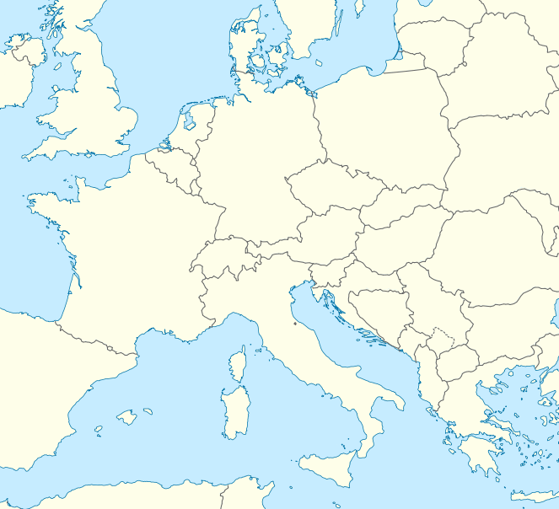





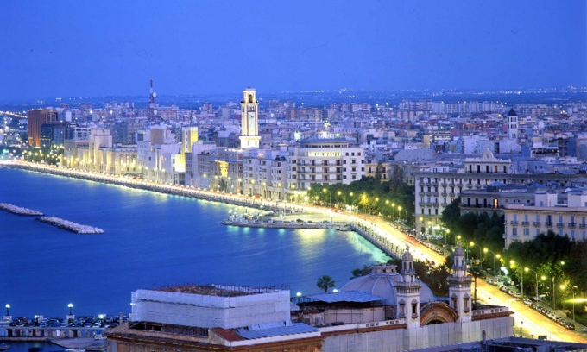


$> whoami
111
Computer Engineering (BSc and MSc degree)
2005 – 2010
Researcher (computer networks area)
Vienna
2010 – 2015
PhD (Institute of Telecommunications)
Rome
2012 – 2015
Bari
Bari (Italy)
Rome (Italy)
Vienna (Austria)
Pierdomenico Fiadino – Barcelona, Feb. 11th 2016...............
Slide #2

Slide 3
$> ls ~/projects | grep ”network monitoring and analysis”
Vermobil
RoadCell
2010 - 2012
Mobility studies (ITS)
leveraging cellular network monitoring
Collaborations: Austrian highway corporation, Telekom Austria (A1), Austrian civil engineering consultancy companies
Goals: study macro mobility on national-level
Identification of popular trajectories and O/D matrices
Inference of road traffic conditions
Identification of transport means
Pierdomenico Fiadino – Barcelona, Feb. 11th 2016...............
Slide #3

Slide 4
Passive Measurements
111
Access Network
network operator
test drives
devices
test terminal
passive probe
Signaling messages from
A/Gb/IuPS/IuCS
interfaces
Cell sequences on highways
Handovers
Location Area Updates
network traces
Network to geographical mobility
Streaming data-warehouse (SQL)
Calls/SMS
...
Pierdomenico Fiadino – Barcelona, Feb. 11th 2016 Slide #4

Slide 5
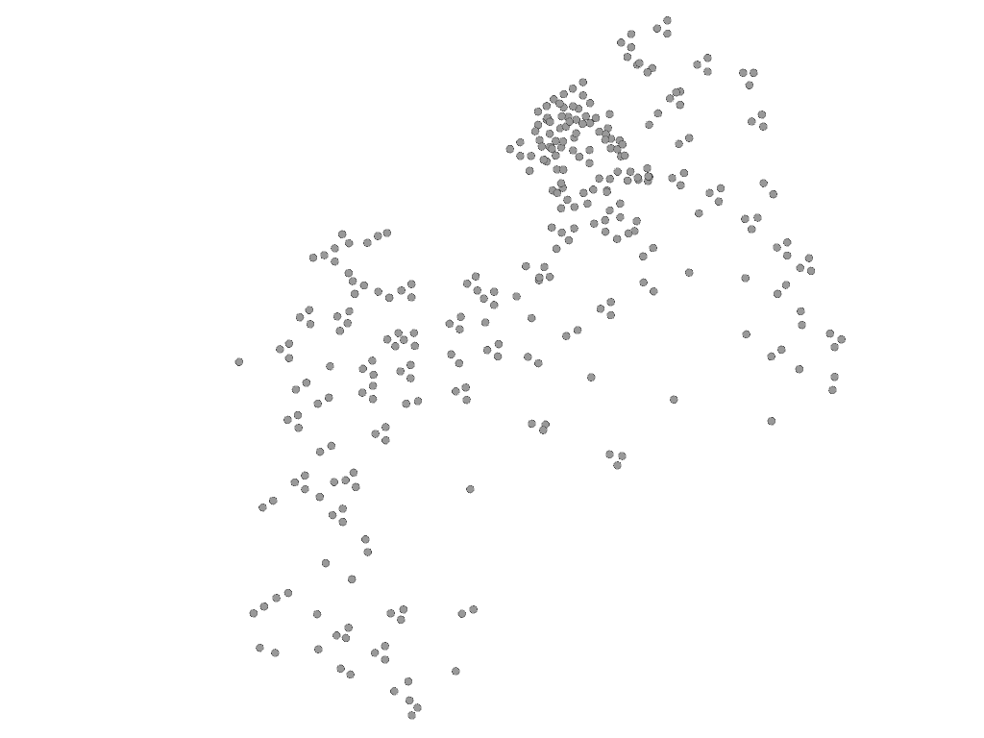
From raw data to highway data
Pierdomenico Fiadino – Barcelona, Feb. 11th 2016...............
Slide #5

Slide 6
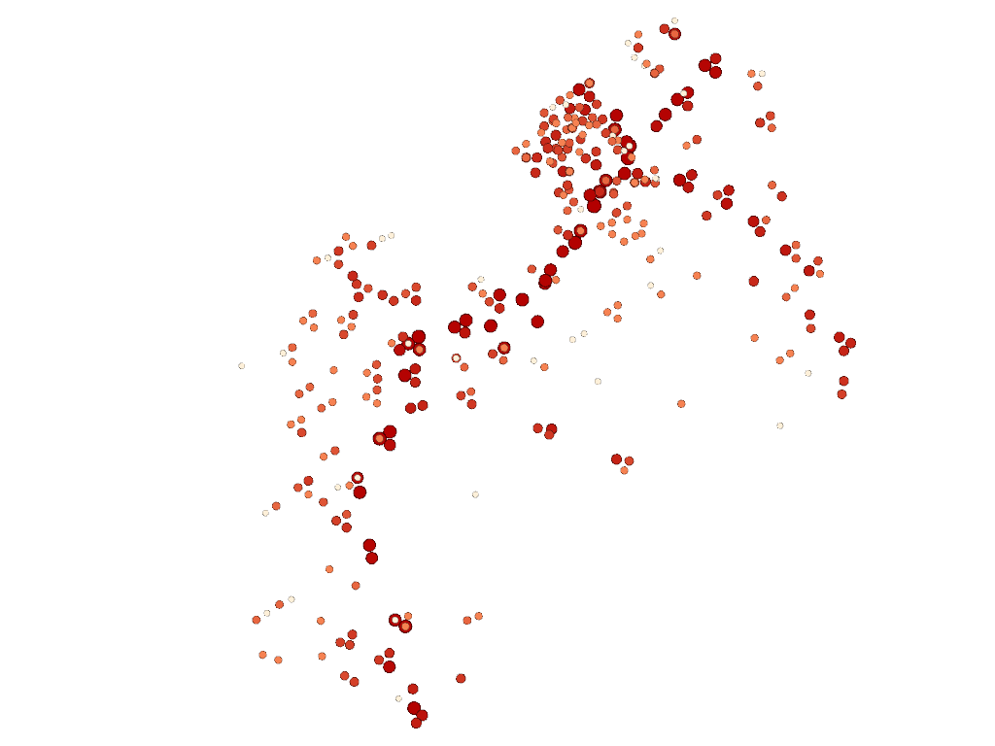
From raw data to highway data
Pierdomenico Fiadino – Barcelona, Feb. 11th 2016...............
Slide #6

Slide 7
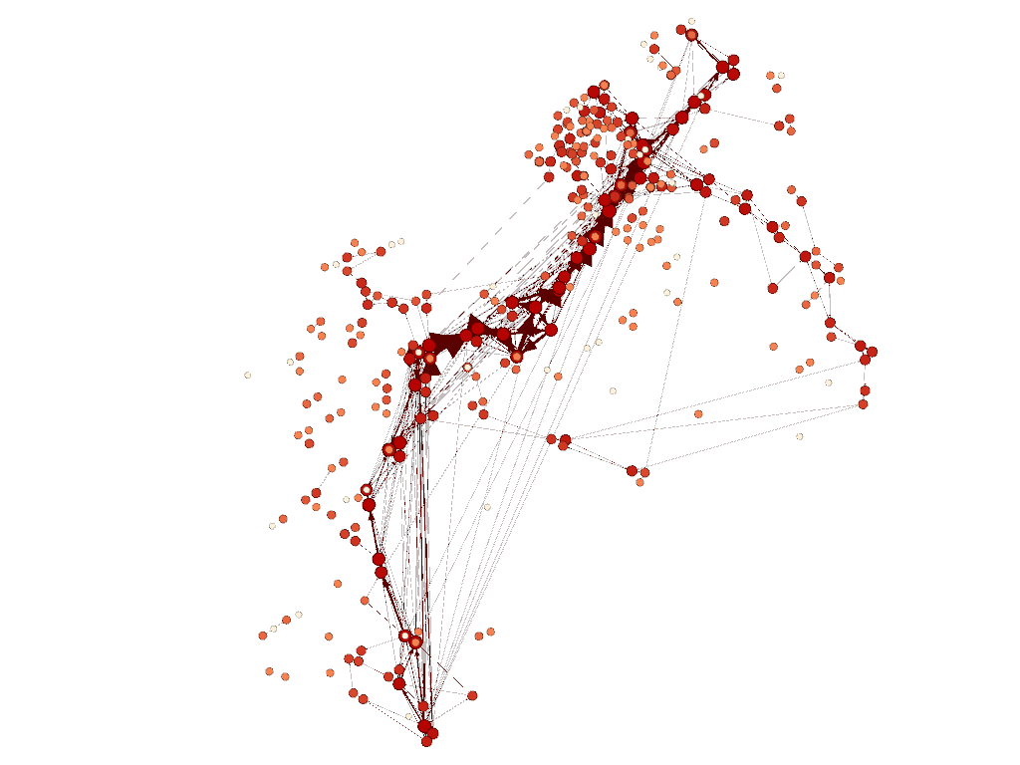
From raw data to highway data
Pierdomenico Fiadino – Barcelona, Feb. 11th 2016...............
Slide #7

Slide 8
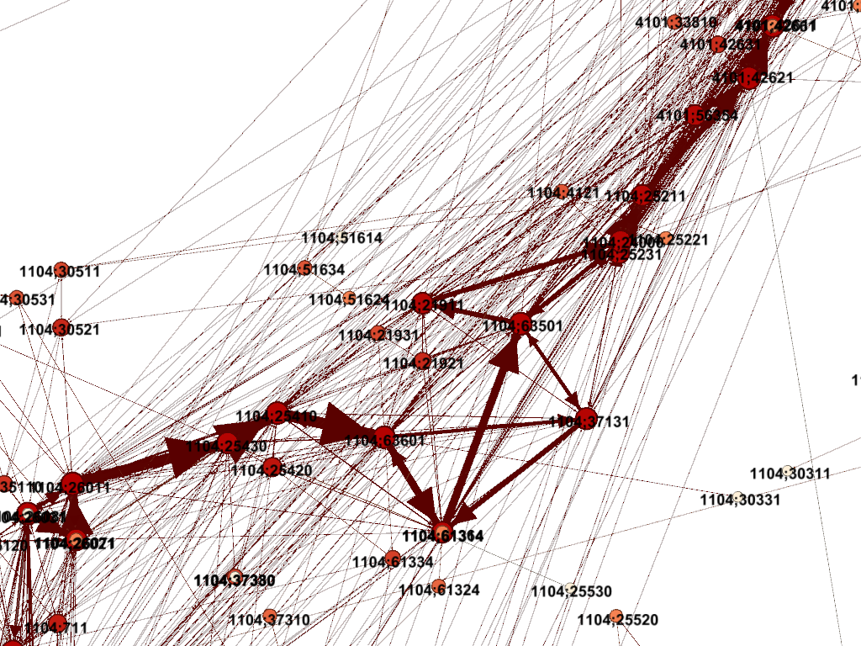
From raw data to highway data
Pierdomenico Fiadino – Barcelona, Feb. 11th 2016...............
Slide #8

Slide 9
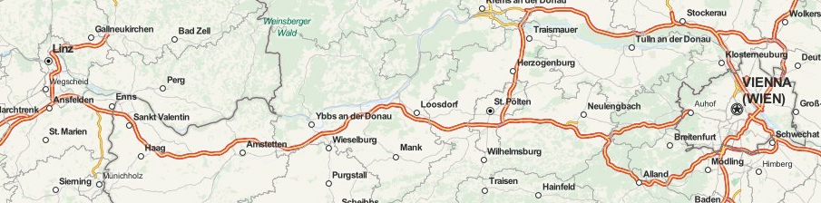
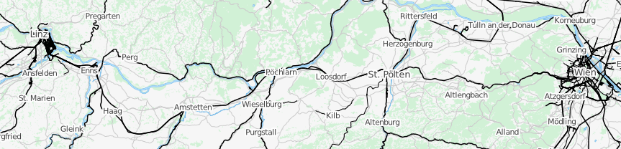
Means of transport differentiation
Highway network:
Linz
Vienna
Railway network:
Linz
Vienna
Pierdomenico Fiadino – Barcelona, Feb. 11th 2016...............
Slide #9

Slide 10
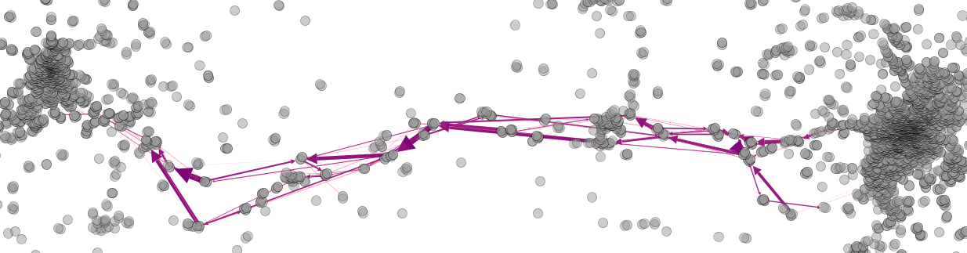
Means of transport differentiation
Linz
Vienna
St. Pölten
Amstetten
Legend
cell
transition
highway
railway
Pierdomenico Fiadino – Barcelona, Feb. 11th 2016...............
Slide #10

Slide 11
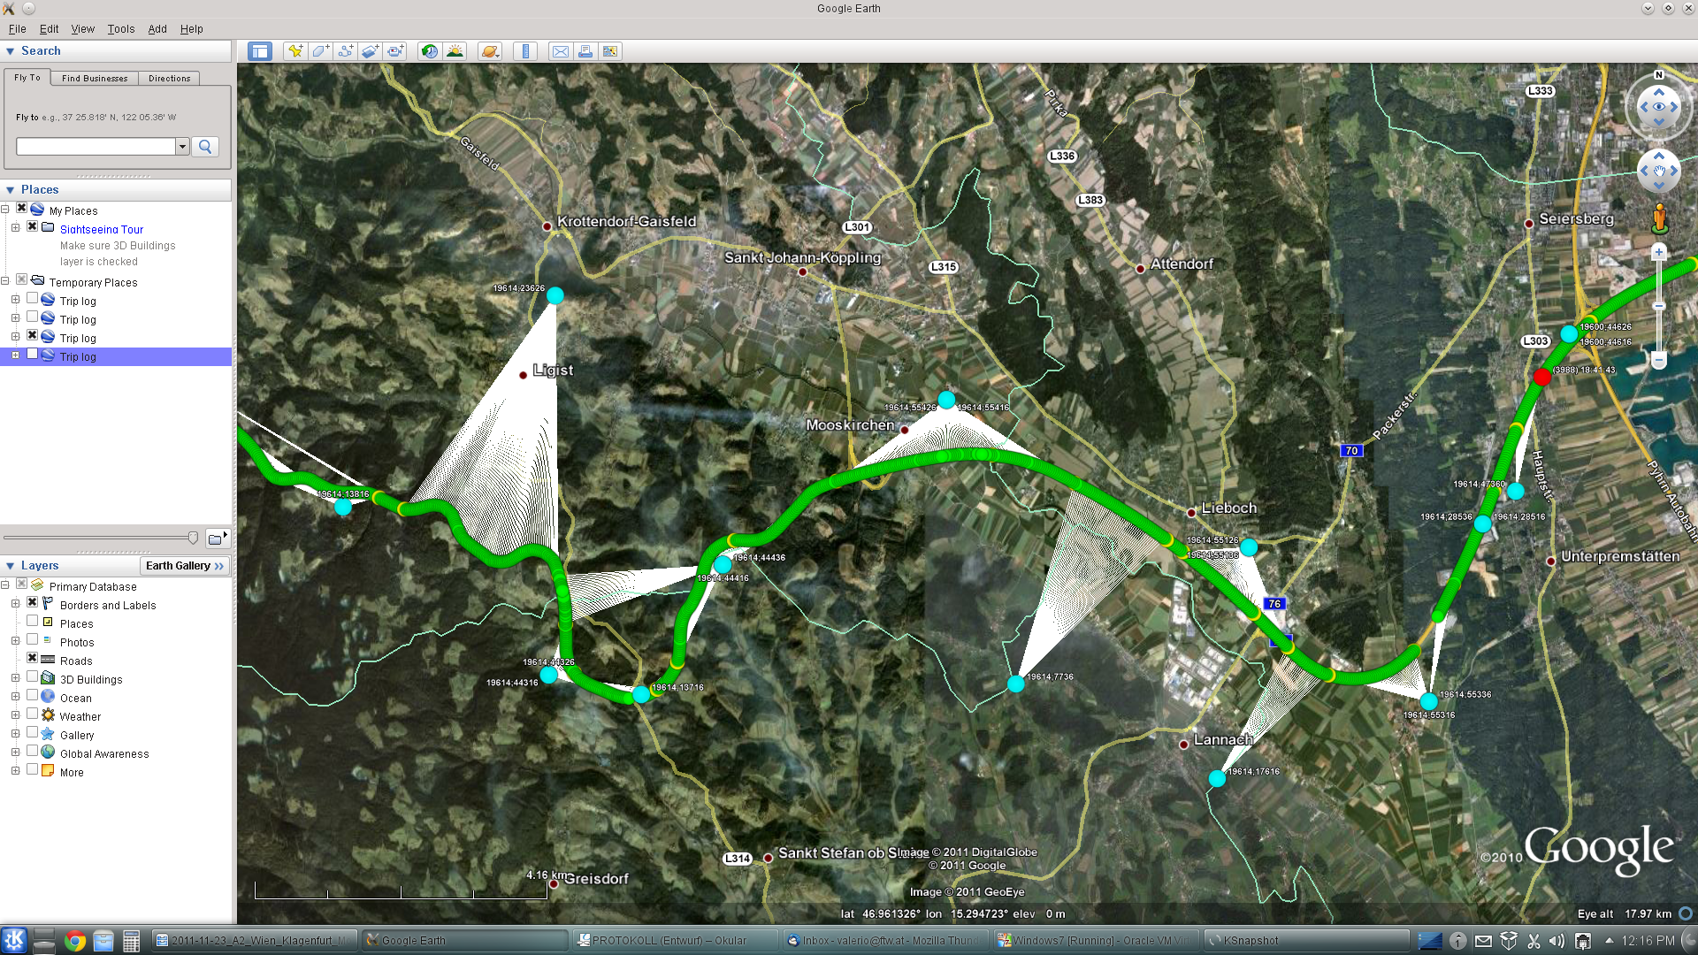
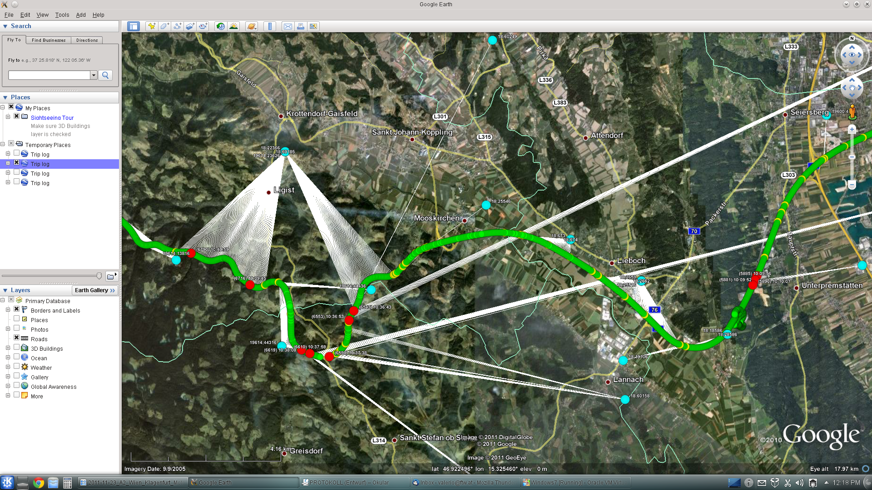
From raw data to highway data
Pierdomenico Fiadino – Barcelona, Feb. 11th 2016...............
Slide #11

Slide 12
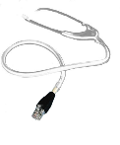

$> ls ~/projects | grep ”network monitoring and analysis”
Vermobil
Darwin
RoadCell
2010 - 2012
2012 - 2015
Mobility studies (ITS)
leveraging cellular network monitoring
Internet traffic monitoring and analysis
Collaborations: Austrian highway corporation, Telekom Austria (A1), Austrian civil engineering consultancy companies
Collaborations: Telcos, Universities, etc.
Goals: Web traffic classification, Internet traffic characterization (focus on popular applications), anomaly detection and diagnosis...
Goals: study macro mobility on national-level
Identification of popular trajectories and O/D matrices
Inference of road traffic conditions
The topic of this talk!
Identification of transport means
Pierdomenico Fiadino – Barcelona, Feb. 11th 2016...............
Slide #12

Slide 13





Passive Measurements
111
Access Network
internet
network operator
passive probe
devices
Gn interface
HTTP tickets
Characterization and Diagnosis
DNS tickets
network traces
Streaming data-warehouse (SQL)
TCP-level statistics
...
Pierdomenico Fiadino – Barcelona, Feb. 11th 2016...
Slide #13

Slide 14


Rewinding the clock of the Internet to a decade ago...
Traffic volume dominated by P2P applications
Simpler Web provisioning infrastructures
path
client
server
Rudimental monitoring tools and simpler problems

Slide 15
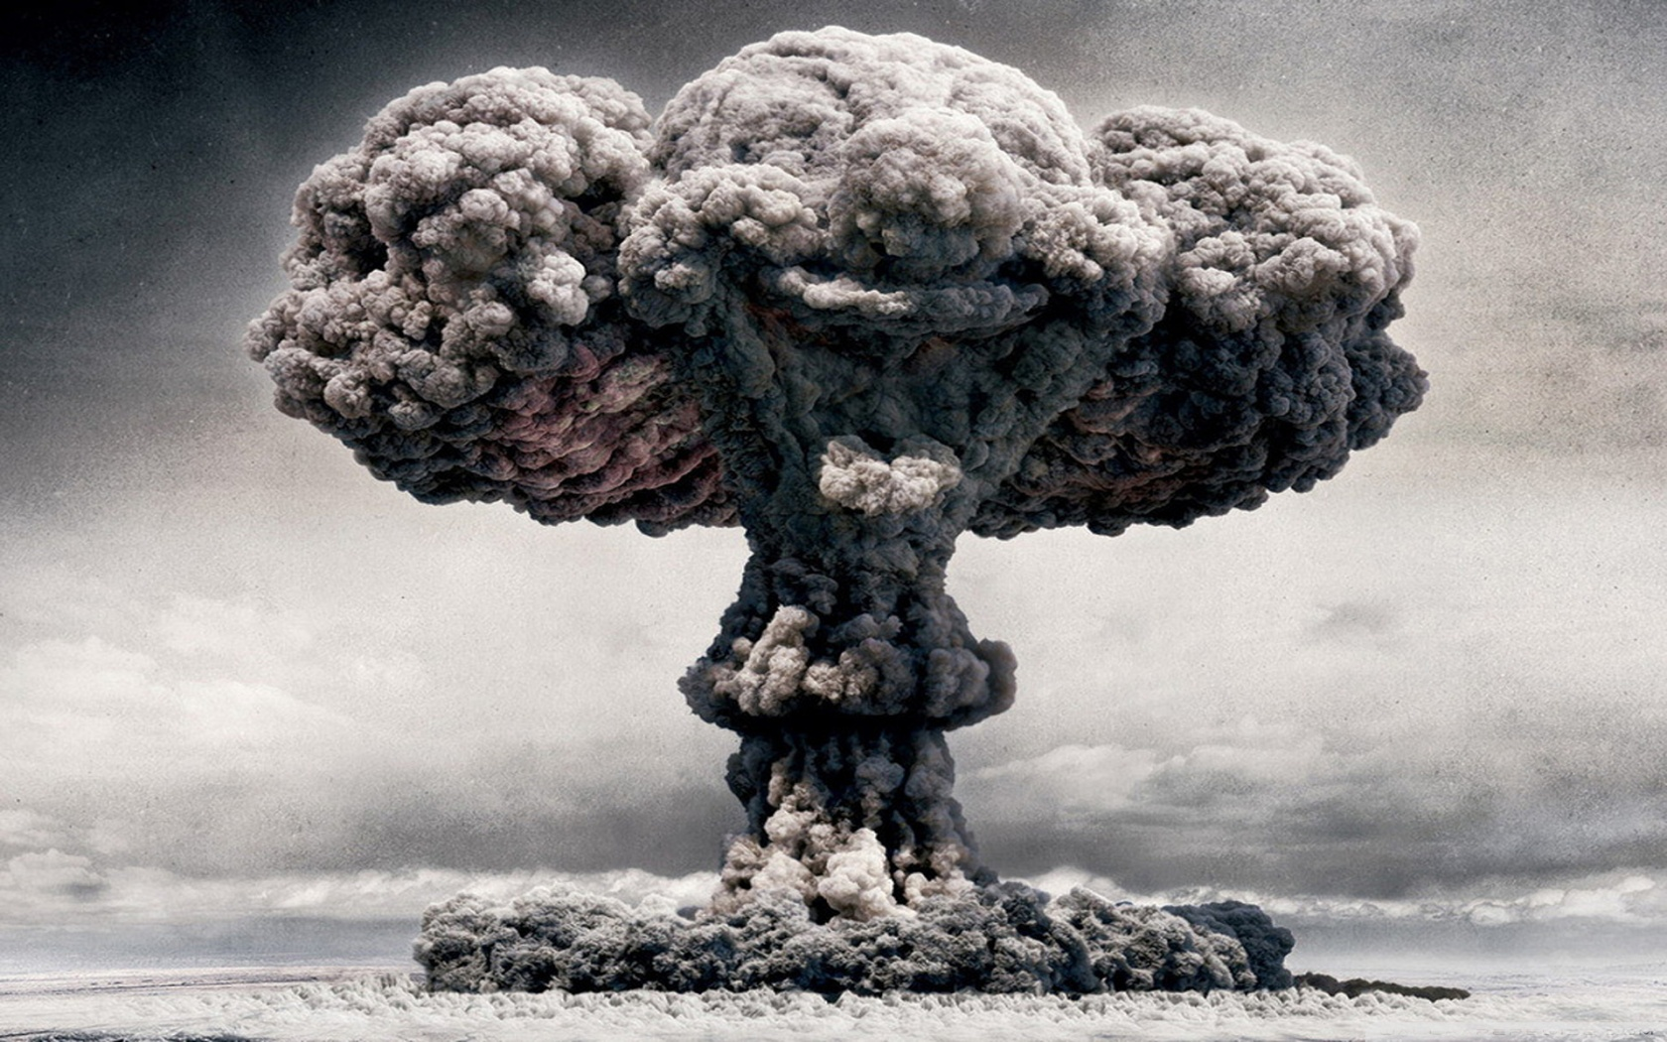
nowadays
Internet’s landscape
has drastically changed
nowadays
Internet’s landscape
has drastically changed
P. Fiadino – PhD Defense – Deceber 10th, 2015...............
Slide #15

Slide 16












Complex Applications and Provisioning Systems
cloud platforms
online social networks
media streaming
Latency
and bandwidth
sensitive
Large
user-base
High traffic volume
Need for sophisticated and highly distributed hosting infrastructures
optimize underlying network usage
increase users‘ Quality of Experience
Content Delivery Networks (CDN)
Pierdomenico Fiadino – Barcelona, Feb. 11th 2016...............
Slide #16

Slide 17
Content Delivery Networks and load balancing
CDNs: pushing contents as close as possible to final users and deploy multiple replicas
CDN network
Users dynamically redirected
Local
DNS
(1) Client requests content to FE
Service
FEs
Load-balancing through
DNS differentiation
(3) Client resolves
Content server name
Other techniques: ANYCAST
(2) FE replies with content server name
Distributed FrontEnds (FEs)
Content
Servers
client
(4) Client requests content
Distributed Content Servers (replicas)
Many organizations, ASes and FQDNs are involved in providing the service
Pierdomenico Fiadino – Barcelona, Feb. 11th 2016...............
Slide #17

Slide 18

The Uphill Race to Network Monitoring & Analysis
111
Relevance for ISPs
content caching
resource planning
traffic engineering
trend analysis
anomaly detection and diagnosis
...
…but we miss the technology to understand what is happening in the network and to optimize its performance and utilization*
*especially when something goes wrong...
‘‘
The Internet is the first thing that humanity has built that humanity doesn't understand, the largest experiment in anarchy that we have ever had.
Eric Schmidt
Alphabet Inc chairman
Pierdomenico Fiadino – Barcelona, Feb. 11th 2016...............
Slide #18
Notes:
Rimuoverla o alleggerirla,comuqneu andare piu veloce

Slide 19
Research Questions
111
My contributions in the filed of Network Traffic Monitoring and Analysis (nTMA)
Q₁
Learn how to track the Internet’s “Big Players”
service differentiation in large-scale operational networks
(in a cyphered-Internet)
Q₂
Study their provisioning systems, load balancing dynamics and flow characteristics
characterization of normal operations and anomalous behaviors
Q₃
Design algorithms for automatic detection and diagnosis of network anomalies
devise a more structured approach that facilitates the troubleshooting
Pierdomenico Fiadino – Barcelona, Feb. 11th 2016...............
Slide #19

Slide 20






Data sources and tools
In-network passive measurements
operational networks, cellular and fixed-line
Access Network
Internet
Metawin
(cellular network)
ISP network
devices
Tstat
(fixed-line network)
network traces
Streaming data-warehouse (SQL)
BigData analytics
Active measurements
ping, traceroute
localhost> ping google.com
PING google.com (1.1.1.1) 56(84) bytes of data
64 bytes from google.com: icmp_seq=1 ttl=57 time=15.8ms
64 bytes from google.com: icmp_seq=2 ttl=57 time=11.9ms
Distributed measurements
RIPE Atlas framework
Hybrid Measurements
Generate traffic and capture it with packet analyzers (Wireshark)
GeoIP Datasets
MaxMind (<IP-AS> and <IP-Country> mappings)
Pierdomenico Fiadino – Barcelona, Feb. 11th 2016...............
Slide #20

Slide 21
Research Questions
111
My contributions in the filed of Network Traffic Monitoring and Analysis (nTMA)
Q₁
Learn how to track the Internet‘s “Big Players”
service differentiation in large-scale operational networks
(in a cyphered-Internet)
Q₂
Study their provisioning systems, load balancing dynamics and flow characteristics
characterization of normal operations and anomalous behaviors
Q₃
Design algorithms for automatic detection and diagnosis of network anomalies
devise a more structured approach that facilitates the troubleshooting
Pierdomenico Fiadino – Barcelona, Feb. 11th 2016...............
Slide #21

Slide 22



Service differentiation through pattern matching
111
URL: http://www.bbc.co.uk/...
Timestamp = 1400001684
Req. bytes = 172
Res. bytes = 420
Server IP = 1.1.1.1
[...]
HTTP ticket
regular expressions
service
^www\.google(\.[a-z]{2,3}){1,2}$
Google (search)
^www\.facebook\.com$
Facebook
^www\.fbcdn\.net$
Facebook
pattern matching
^www\.bbc\.(co\.uk|com)$
BBC
Example: Facebook regex (((|%.)(facebook.com|fbcdn.net))|((fbcdn|fbstatic)%.akamaihd.net))
a
b
manually defined patterns
initial effort, but quite high stability
classify by pattern-matching
on requested URL
c
easy discovery of new popular services
d
allows association between server IP and service
Pierdomenico Fiadino – Barcelona, Feb. 11th 2016...............
Slide #22

Slide 23
Leveraging DNS for encrypted protocols
idea
use passively collected DNS requests to dynamically map <services,serverIPs>
validity period (TTL)
resolve: www.youtube.com
A: <IP₁,IP₂,..>, TTL
userID | FQDN | IP | start | end
user #1 | www.yt.com | 1.1.1.1 | 14041347 | 14041349
user #2 | www.fb.com | 2.2.2.2 | 14030424 | 14031288
... | ... | ... | ... | ...
client #1
DNS server
resolve: www.facebook.com
client #2
A: <IP₁,IP₂,..>, TTL
Passive probe
local mapping
1
build a local mapping of <fqdn> and <server_ip>, with specific vality period, by observing passive traces
2
every subsequent flow between a <user> and a <server_ip> in the validity period [validity_start:validity_end] are assigned to <FQDN>
3
the Fully Qualified Domain Names (FQDN) are assigned
to service with usual pattern matching (previous slide)
Pierdomenico Fiadino – Barcelona, Feb. 11th 2016...............
Slide #23

Slide 24
Service Differentiation -- Summary
my main
contributions
An on-line system for web traffic classification (HTTPTag) relying on headers
An extension considering DNS traffic for encrypted protocols (HTTPTag2)
designed, implemented and deployed in operational cellular networks
other contributions (not shown)
Evaluation of HTTPTag (classification rate in operational cellular network)
Long-term tracking capabilities of HTTPTag (antivirus definition updates and others)
Mini-IPc: a simple IP-based classifier (evaluation and limitations)
DNS extension for encrypted XMPP-based applications (e.g., WhatsApp)
publications
INFOCOM 2013 Poster Session , IWCMC 2013, ACM SIGCOM 2014 Poster Session
Pierdomenico Fiadino – Barcelona, Feb. 11th 2016...............
Slide #24

Slide 25
Research Questions
111
My contributions in the filed of Network Traffic Monitoring and Analysis (nTMA)
Q₁
Learn how to track the Internet‘s „Big Players“
service differentiation in large-scale operational networks
(in a cyphered-Internet)
Q₂
Study their provisioning systems, flow characteristics and load balancing dynamics
characterization of normal operations and anomalous behaviors
Q₃
Design algorithms for automatic detection and diagnosis of network anomalies
devise a more structured approach that facilitates the troubleshooting
Pierdomenico Fiadino – Barcelona, Feb. 11th 2016...............
Slide #25

Slide 26



Internet-scale applications: three study cases
Characterization of popular applications
(chosen according to their relevance, generated traffic volume and user-base size)
during their normal operations
Instant Messaging
cellular dataset
Online Social Network
cellular dataset
Video Streaming
cellular and fixed-line dataset
a
Hosting infrastructure discovery
Server IPs, AS/CDN/companies involved, geographical (MaxMind) and topological (RTT) positioning
b
Study of Temporal Dynamic Characteristics
Unveil traffic seasonality, load balancing policies by observing IP addresses and minRTT
c
Flow Characteristics and QoE Implications
Average throughput, QoE-based KPIs (e.g., video bitrate/throughput ration)
Pierdomenico Fiadino – Barcelona, Feb. 11th 2016...............
Slide #26

Slide 27
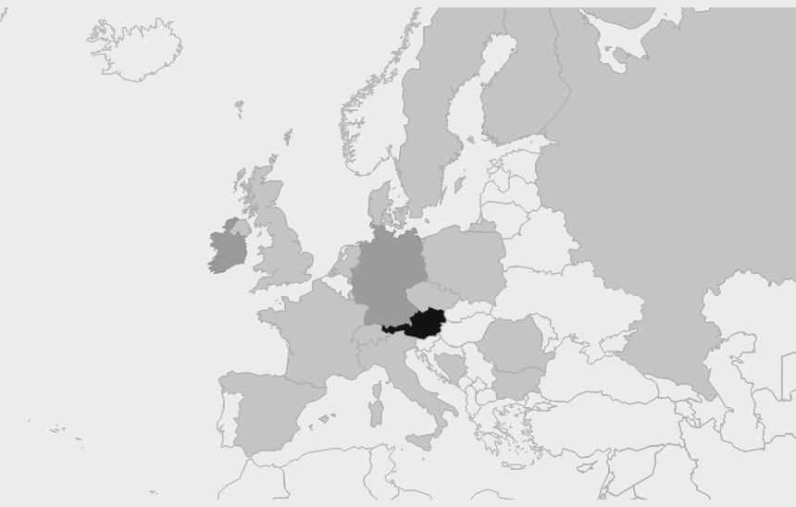

A. Hosting Infrastructure (Facebook case)
Geographical diversity
FB. traffic sources to Austria
(cellular network)
Austria (same country)
37.2%
Ireland
12.7%
Germany
2.1%
USA
1.1%
Rest of Europe
46.3%
99% traffic from
within Europe
1
Strong content localization
2
Akamai datacenters in Europe play biggest role
3
ISP caching: local and neighboring countries
Pierdomenico Fiadino – Barcelona, Feb. 11th 2016...............
Slide #27

Slide 28
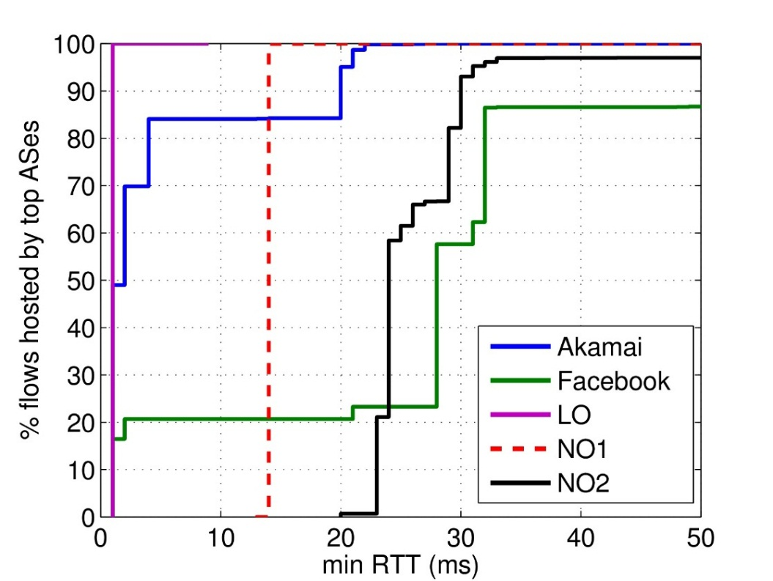
A. Hosting Infrastructure (where are the caches?)
111
Distribution of min RTT per service and per hosting organization (num. flows weighted)
Facebook example
min RTT approximate propagation delay
Knees in the distributions correspond to different hosting locations
AkamaiAS: very short RTT
(highly distributed and close to final users)
Akamai
Facebook AS
Local ISP
Deutsche T.
Intuitively ISPs (Local ISP and Deutsche Telekom) have small geographical diversity
TeliaNet
Pierdomenico Fiadino – Barcelona, Feb. 11th 2016...............
Slide #28

Slide 29
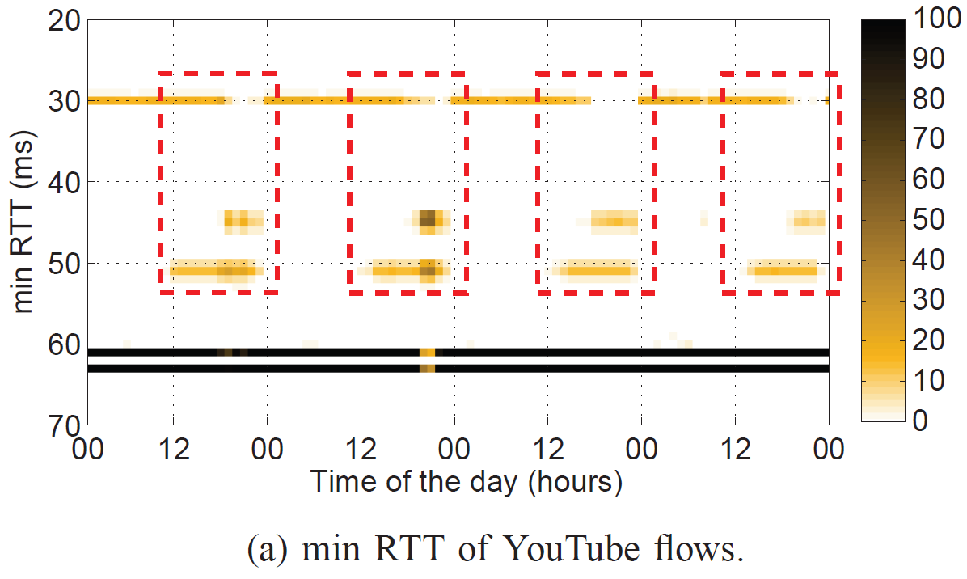
B. Temporal Patterns: heat maps visualization
111
Heatmaps for unveiling involved locations/datacenters and their inter-play
minRTT Heat-map evolution
(concentration of flows in different locations/datacenters)
Google CDN (Youtube) uses load balancing
contents from different locations depending on time/load
Google CDN presents marked RTT shifts
daily periodic patterns and a stable hosting locations
minRTT of Youtube flows (Google CDN)
Results from operational cellular network (millions of users)
Pierdomenico Fiadino – Barcelona, Feb. 11th 2016...............
Slide #29

Slide 30
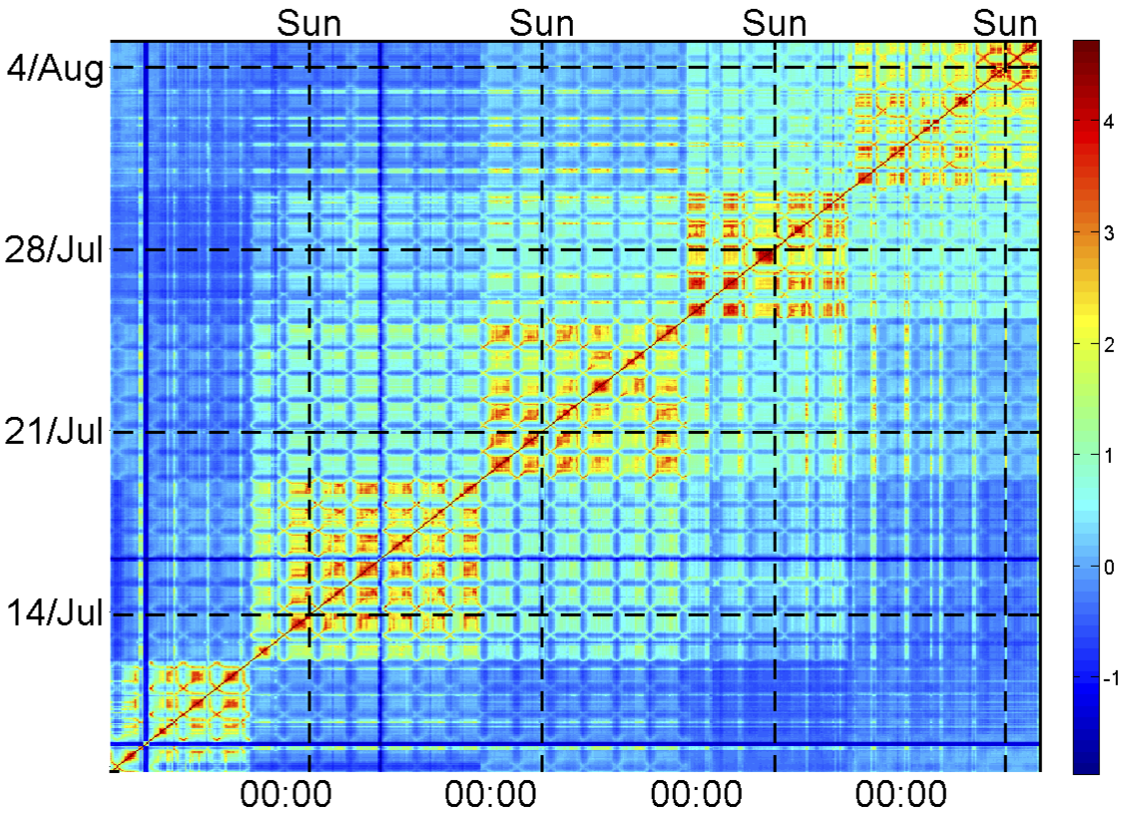
B. Temporal Patterns: heat map visualization
Temporal Similarity Plot (TSP)
A powerful heatmap-like tool for visualizing temporal patterns
Discover temporal patterns and (ir)regularities in distribution timeseries
Long-term distribution of flows across Akamai subnets (Facebook case)
as observed in a cellular networks (millions of users)
How to build a TSP
week 4
Count flow numbers/volume for every IP
1
Cumulate counters per unit of time (e.g. 1h)
week 3
2
Calculate distributions per time-bin
3
week 2
Compare distributions (Kullback-Leibler)
4
Plot comparisons on heatmap (logscale)
week 1
5
week 2
week 3
week 4
uniform settings
Pierdomenico Fiadino – Barcelona, Feb. 11th 2016...............
Slide #30

Slide 31
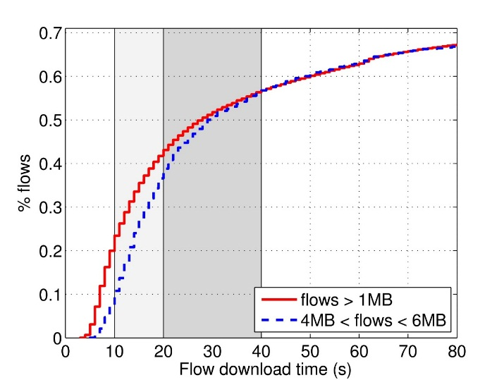
C. Flow Characteristics and QoE (WhatsApp)
111
Distribution of download time (as seen in large-scalepassive traces)
[video exchange in chat application]
40% flows last less than 20s (good)
60% flows last less than 40s (acceptable)
35% flows are badly/very badly perceived
From laboratory experiment to operational networks
(large scale measurements)
Map network characteristics to user assigned score (from 1 to 5)
Laboratory experiments with network controlled environments and real users
The score is independent of the flow size (e.g., independent of video quality)
Laboratory Experiments
QoE models
Users tolerate transfers (in chat apps) of up to 20 seconds with good experience
Threshold of 40 seconds discriminates good and bad experience
The score is independent of the flow size (e.g., independent of video quality)
Laboratory Experiments
Results
media transfer in IMM
Pierdomenico Fiadino – Barcelona, Feb. 11th 2016...............
Slide #31
Notes:
Remove details on model and just put the conclusions and of the model and how they apply

Slide 32
Internet-scale applications: three study cases
Characterization of popular applications
(chosen according to their relevance, generated traffic volume and user-base size)
during their normal operations
Instant Messaging
cellular dataset
Online Social Network
cellular dataset
Video Streaming
cellular and fixed-line dataset
a
Hosting infrastructure discovery
Server IPs, AS/CDN/companies involved, geographical (MaxMind) and topological (RTT) positioning
b
Study of Temporal Dynamic Characteristics
Unveil traffic seasonality, load balancing policies by observing IP addresses and minRTT
c
Flow Characteristics and QoE Implications
Average throughput, QoE-based KPIs (e.g., video bitrate/throughput ration)
d
Anomalies!
Outages, pattern changes with negative implications
!
Pierdomenico Fiadino – Barcelona, Feb. 11th 2016...............
Slide #32

Slide 33
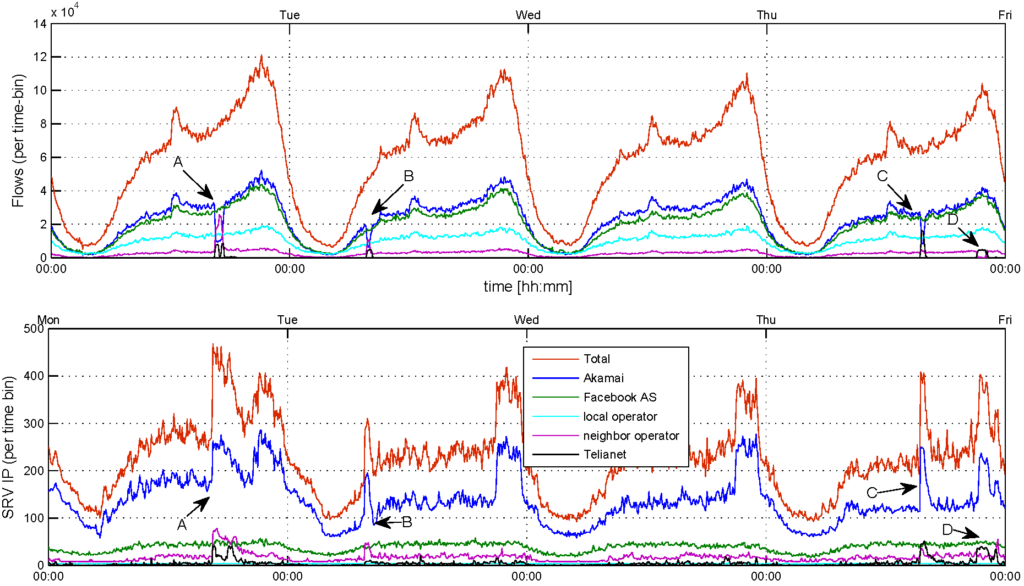
Facebook traffic and CDN inter-play anomalies
Anomalous events (frequent)
Traffic drop in Akamai AS (drop in number of served flows, active IPs)
Deutsche Telekom and TeliaNet deploy back-up machines (increase number of active IPs) and together take over the role of Akamai
flows
srv IP
Total
Akamai
Facebook AS
Local ISP
Deutsche T.
TeliaNet
constant share of traffic among CDNs
Facebook AS and Akamai lead in terms of flow num.
Akamai deploys the largest number of IP per time unit
Pierdomenico Fiadino – Barcelona, Feb. 11th 2016...............
Slide #33

Slide 34


Facebook traffic and CDN inter-play
111
No impacts for users. Why should operators care?
Potential economical loss for ISP
p2p
(free)
:(
c2p
($$$)
Local operator
TeliaNet
AS
AS
Akamai
AS
Deutsche Telekom
c2p
($$$)
AS
CAIDA’s AS-relations dataset
Pierdomenico Fiadino – Barcelona, Feb. 11th 2016...............
Slide #34

Slide 35
Change of CDN policies and QoE degradation
111
Requestes served by different /24 subnets
..which correspond to different data centers
The Youtube case
Measurements from a single vantage poing (fixed-line)
 |  | 5-May |  | 6-May |  | 7-May |  | 8-May |  | 9-May |  | 10-May
SUBNET | NAME with AIRPORT code | #flow | Thr avg | #flow | Thr avg | #flow | Thr avg | #flow | Tru avg | #flow | Tru avg | #flow | Tru avg
173.194.18 | fra02s08.c.youtube.com | -1 | -1 | -1 | -1 | -1 | -1 | 6139 | 368.93 | 6266 | 298.4 | 5389 | 228.76
173.194.19 | fra02s15.c.youtube.com | -1 | -1 | -1 | -1 | -1 | -1 | 9940 | 258.18 | 12893 | 196.06 | 7012 | 166.48
173.194.2 | mil01s12.c.youtube.com | 17054 | 1333.46 | 15470 | 1276.31 | 13655 | 1259.63 | 14186 | 1296.07 | 12616 | 1197.64 | 13860 | 1338.63
173.194.20 | par08s06.c.youtube.com | -1 | -1 | -1 | -1 | -1 | -1 | -1 | -1 | -1 | -1 | -1 | -1
173.194.208 | par08s06.c.youtube.com | -1 | -1 | -1 | -1 | -1 | -1 | -1 | -1 | 487 | 414.63 | 71 | 711.54
173.194.5 | lhr14s08.c.youtube.com | 449 | 1819.57 | 283 | 1658.45 | -1 | -1 | 3470 | 937.18 | 4222 | 1025.49 | 6191 | 1166.08
173.194.6 | fra07s13.c.youtube.com | -1 | -1 | -1 | -1 | -1 | -1 | 4924 | 412.17 | 8749 | 331.14 | 7224 | 318.83
173.194.62 | fra07s19.c.youtube.com | -1 | -1 | -1 | -1 | -1 | -1 | 6160 | 325.82 | 6877 | 248.39 | 6108 | 274.55
173.194.9 | par03s06.c.youtube.com | -1 | -1 | -1 | -1 | -1 | -1 | -1 | -1 | 87 | 355.1 | -1 | -1
208.117.236 | par03x04.c.youtube.com | 179 | 164.18 | 4250 | 540.16 | 957 | 496.91 | -1 | -1 | -1 | -1 | -1 | -1
208.117.248 | mia02s11.c.youtube.com | -1 | -1 | 77 | 552 | -1 | -1 | -1 | -1 | -1 | -1 | -1 | -1
208.117.250 | ams09x06.c.youtube.com | 41430 | 679 | 49437 | 656.39 | 57675 | 653.81 | 567 | 906.65 | -1 | -1 | -1 | -1
208.117.252 | dfw06x02.c.youtube.com | -1 | -1 | 51 | 285.63 | -1 | -1 | -1 | -1 | -1 | -1 | -1 | -1
208.117.254 | fra07x03.c.youtube.com | 838 | 667.29 | 2130 | 852.53 | -1 | -1 | 465 | 606.1 | 126 | 1146.87 | 1033 | 1379.76
74.125.105 | lhr22s16.c.youtube.com | 1829 | 1551.78 | 1655 | 1185.94 | 3957 | 942.47 | 3454 | 990.64 | 4116 | 1061.72 | 7657 | 1126.83
74.125.13 | zrh04s03.c.youtube.com | 719 | 1074.15 | 499 | 2264.09 | 82 | 1302.03 | -1 | -1 | -1 | -1 | -1 | -1
74.125.14 | mil02s01.c.youtube.com | 48366 | 1234.82 | 37968 | 1253.01 | 37182 | 1162.85 | 47844 | 1298.45 | 52594 | 1226.85 | 37755 | 1143.37
74.125.216 | bru02t11.c.youtube.com | -1 | -1 | -1 | -1 | -1 | -1 | -1 | -1 | -1 | -1 | -1 | -1
74.125.218 | fra07t13.c.youtube.com | 8697 | 1355.33 | 12579 | 1338.71 | 8560 | 1239 | 11469 | 1256.32 | 11633 | 1292.58 | 10320 | 1276.33
74.125.4 | lhr22s11.c.youtube.com | 1496 | 1846.25 | 2488 | 1034.78 | 4146 | 1363.63 | -1 | -1 | -1 | -1 | -1 | -1
74.125.99 | fra07s03.c.youtube.com | -1 | -1 | -1 | -1 | -1 | -1 | 4221 | 187.84 | 4913 | 189.64 | 2461 | 136.63
flows shifted
flows shifted
Pierdomenico Fiadino – Barcelona, Feb. 11th 2016...............
Slide #35

Slide 36
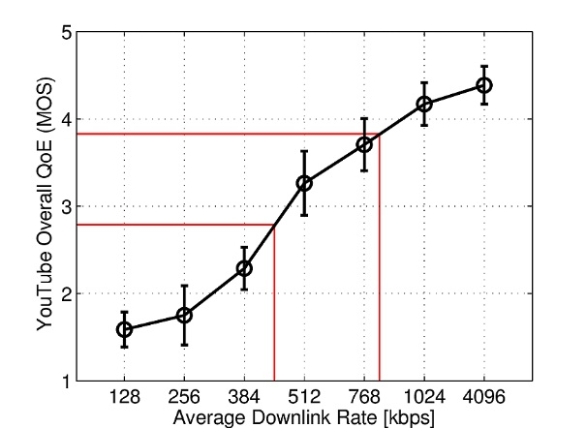
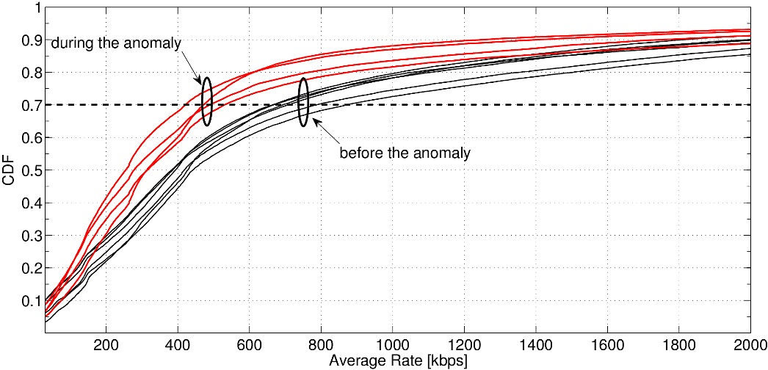
Change of CDN policies and QoE degradation
111
Google‘s cache selection policies might be sub-optimal!
Before: more than70% of flows at ~800Kbps
After: more than 70% of flows at ~448Kbps
MOS = Mean Opinion Score
(1-month field trial, 40 users)
CDFs at peak hours (9pm – 11pm)
before and after change in cache selection policy
Avg. Downlink Rate and QoE (360p)
Loss of 1 QoE point (MOS from 4 to 3): users noticed and complained to customer care
Throughput does not tell the whole story: additional QoE KPIs have been studied (β parameter)
Pierdomenico Fiadino – Barcelona, Feb. 11th 2016...............
Slide #36

Slide 37
Internet-scale services characterization - summary
my main
contributions
Extensive characterization of popular hosting infrastructures
Combination of heterogeneous data source (i.e., passive, active, geoIP, etc.)
Methodology for studying and visualizing temporal evolutions (TSP for CDNs)
Studies in operational networks (thousands/millions of users) and results with high statistical relevance
my other contributions (not shown)
Comparison of hosting infrastructure approaches (more details)
Details on Internet Big Players (“who is hosting who”)
Facebook flow characteristics
Facebook anomalies inspected through Temporal Similarity Plots (TSPs)
Facebook anomalies, characterization of two global outages
YouTube traffic differences in cellular and fixed-line networks
YouTube extended QoE study
WhatsApp reverse engineering of naming scheme (hybrid measurements)
WhatsApp traffic characteristics depending on terminals’ Operating Systems
ITC 2013 B.P.A. PAM 2014 Poster session, IWCM 2014, IWCM 2014, EuCNC 2014, CNSM 2014, IEEE TNSM 2014, ACM SIGCOMM 2014 Poster session, WD 2014 B.P.A. Runner Up,
TMA 2015, IFIP Networking 2015, EuCNC 2015, IWCM 2015
publications
Pierdomenico Fiadino – Barcelona, Feb. 11th 2016...............
Slide #37

Slide 38
Research Questions
111
My contributions in the filed of Network Traffic Monitoring and Analysis (nTMA)
Q₁
Learn how to track the Internet‘s „Big Players“
service differentiation in large-scale operational networks
(in a cyphered-Internet)
Q₂
Study their provisioning systems, load balancing dynamics and flow characteristics
characterization of normal operations and anomalous behaviors
Q₃
Design algorithms for automatic detection and diagnosis of network anomalies
devise a more structured approach that facilitates the troubleshooting
Pierdomenico Fiadino – Barcelona, Feb. 11th 2016...............
Slide #38

Slide 39
Diagnosis framework at a glimpse
111
Network
Traces
(traffic features)
Symptomatic Signal Extraction
Change Detection Module
Diagnosis Module
Symptom query_cnt
Diagnostic manufacture
Diagnostic operative_sys
Diagnostic FQDN
Granularity 30 minutes
Warning_start 2015-02-14
Alarm_start 2015-02-14
alarm_end 2015-02-14
Warning_end 2015-02-14
Symptom query_cnt
Diagnostic manufacture
Diagnostic operative_sys
Diagnostic FQDN
Granularity 30 minutes
Warning_start 2015-02-14
Alarm_start 2015-02-14
alarm_end 2015-02-14
Warning_end 2015-02-14
Symptom query_cnt
Diagnostic manufacture
Diagnostic operative_sys
Diagnostic FQDN
Granularity 30 minutes
Warning_start 2015-02-14
Alarm_start 2015-02-14
alarm_end 2015-02-14
Warning_end 2015-02-14
Symptom query_cnt
Diagnostic manufacture
Diagnostic operative_sys
Diagnostic FQDN
Granularity 30 minutes
Warning_start 2015-02-14
Alarm_start 2015-02-14
alarm_end 2015-02-14
Warning_end 2015-02-14
Symptom query_cnt
Diagnostic manufacture
Diagnostic operative_sys
Diagnostic FQDN
Granularity 30 minutes
Warning_start 2015-02-14
Alarm_start 2015-02-14
alarm_end 2015-02-14
Warning_end 2015-02-14
Event Reports
Diagnostic
Signal Extraction
Change Detection Module
provide support in troubleshooting of anomalous events
passively collected
(e.g., from a mobile network core)
statistical content of diagnostic-symptomatic traffic features
probability distribution-based algorithm
state management, classification, correlation
key idea
1
distinguish between:
key idea
2
observe significant changes in multiple traffic features
symptomatic signals
notify presence of anomalous state
diagnostic signals
provide context for diagnosis
key idea
3
keep status of changes, classify and coordinate
Pierdomenico Fiadino – Barcelona, Feb. 11th 2016...............
Slide #39

Slide 40
Stage #1: Signal Extraction
Signals
describe statistical content of traffic features (e.g., distributions)
experimented with DNS tickets and video flows monitoring
Symptomatic Signals
Network statistics that indicate the presence of anomalies (when they change)
example
QoE-related anomalies (e.g., YouTube/Google)
(degradation of QoE-related KPIs)
Diagnostic Signals
Their change does not indicate presence of anomalies, but support troubleshooting
example
QoE-related anomalies (e.g., YouTube/Google)
(CDN settings, server IPs, RTT, etc.)
Pierdomenico Fiadino – Barcelona, Feb. 11th 2016...............
Slide #40

Slide 41
Traffic Feature Distributions
111
Empirical distribution of flows across throuput ranges (binning)
Change in traffic patterns induce shifts in the distributions of the relevant traffic features
3-4 Mbps
3-4 Mbps
2-3Mbps
Overall decrease of average throughput
(YouTube use case...)
number of flows
>4Mbps
1-2Mbps
Throughput bins (decreasing)
Pierdomenico Fiadino – Barcelona, Feb. 11th 2016...............
Slide #41

Slide 42
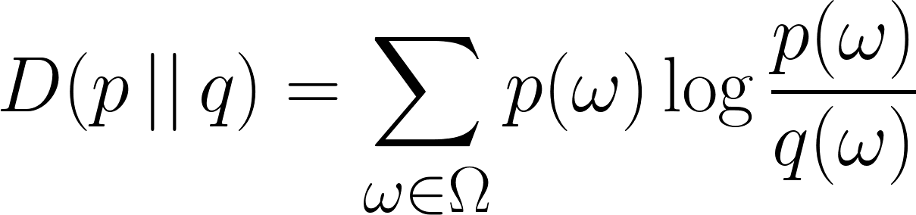
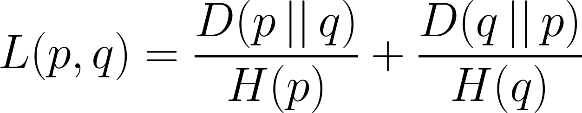
Stage #2: Change Detection
111
Distribution-based detector
Consider whole empirical distribution
instead of just its entropy (as usually done)
Compute distance between distribution and normality reference
i.e. a set of historical anomaly-free distributions
Self-adapting sliding window algorithm for reference identification
my extension to the algorithm (originally based on simple sliding window mechanism)
Distribution distance metric
current distribution at t_{i}
Kullback-Leibler divergence
D_{f}(t_{i}) = 3
Measures how different current distribution is from normality
reference distribution r
Entropy normalized KL metric
Pierdomenico Fiadino – Barcelona, Feb. 11th 2016...............
Slide #42

Slide 43
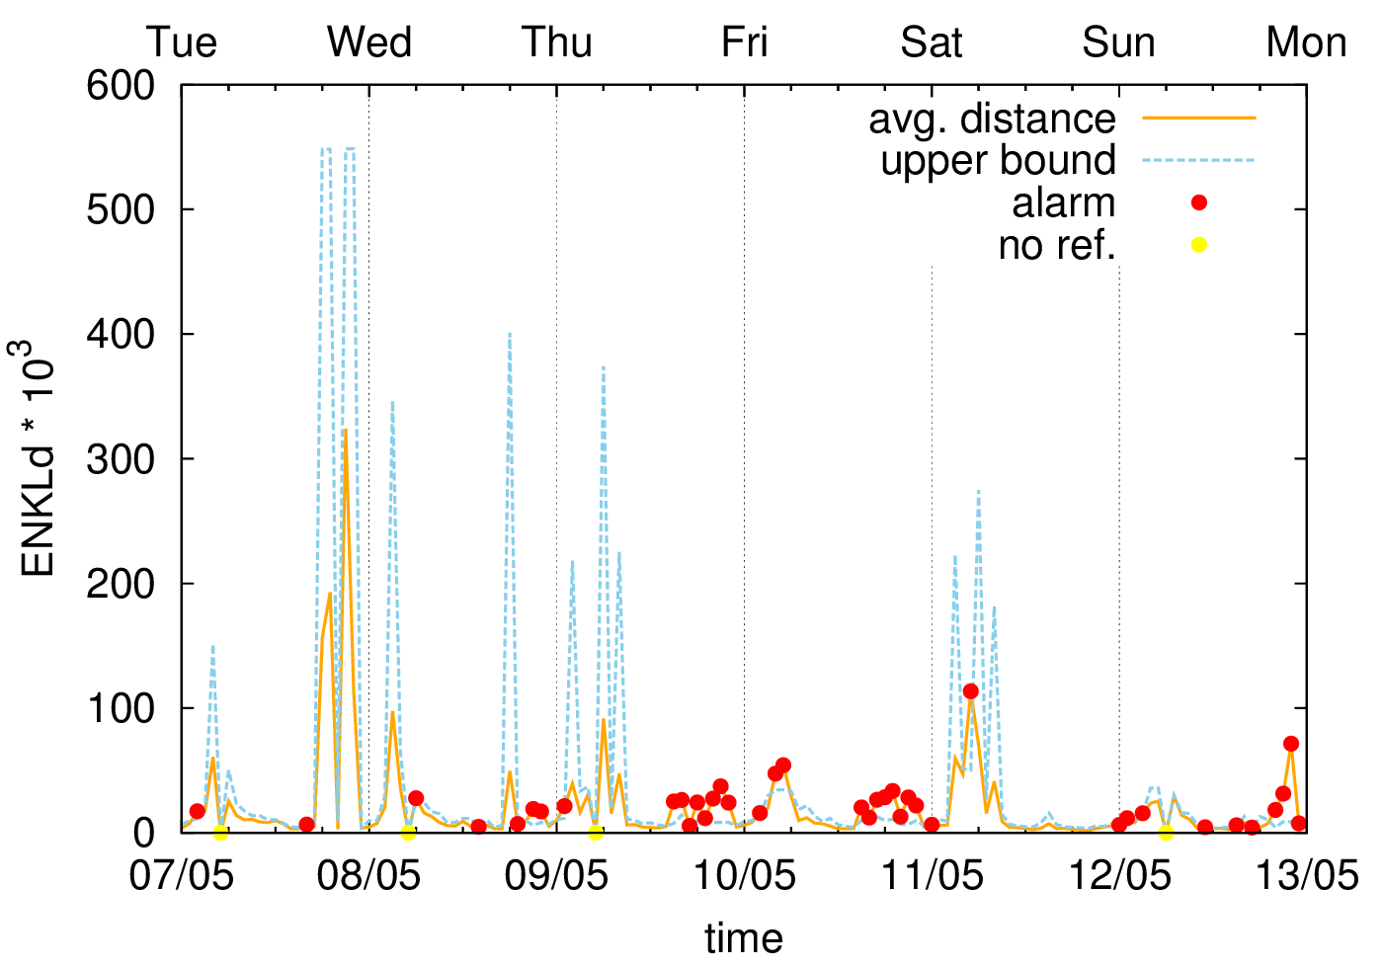
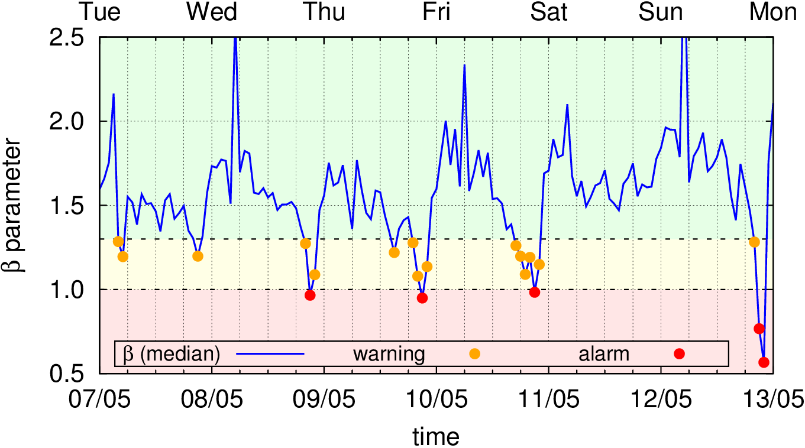
Youtube QoE anomaly: Symptomatic Signals
Distribution of flow count per throughput bins
(distribution-based detection)
Average download throughput change
Performance degradation
β parameter (QoE-based KPI) timeseries
(threshold based detection)
Unacceptable
β paramenter
(<1.25, lab experiments)
QoE impairments
Pierdomenico Fiadino – Barcelona, Feb. 11th 2016...............
Slide #43

Slide 44
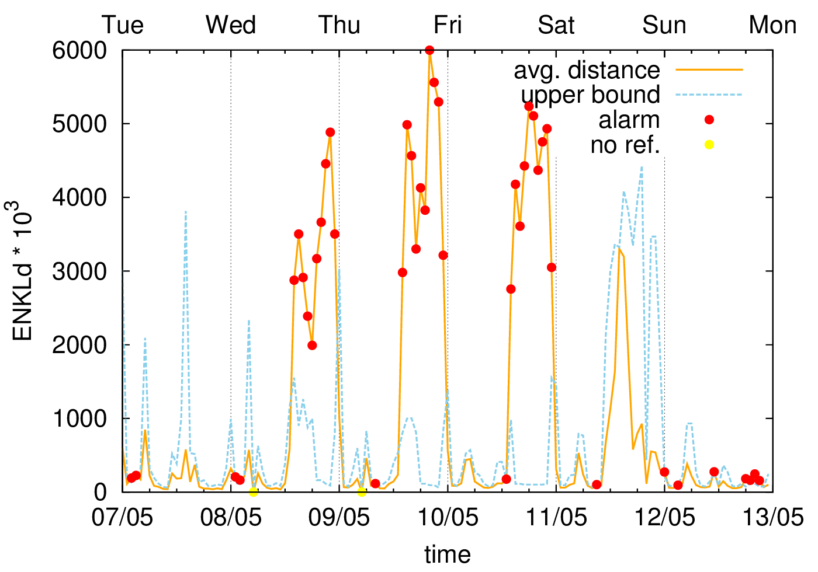
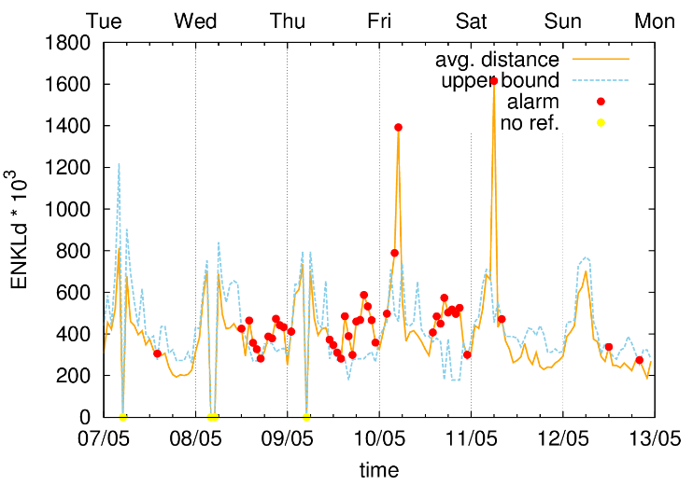
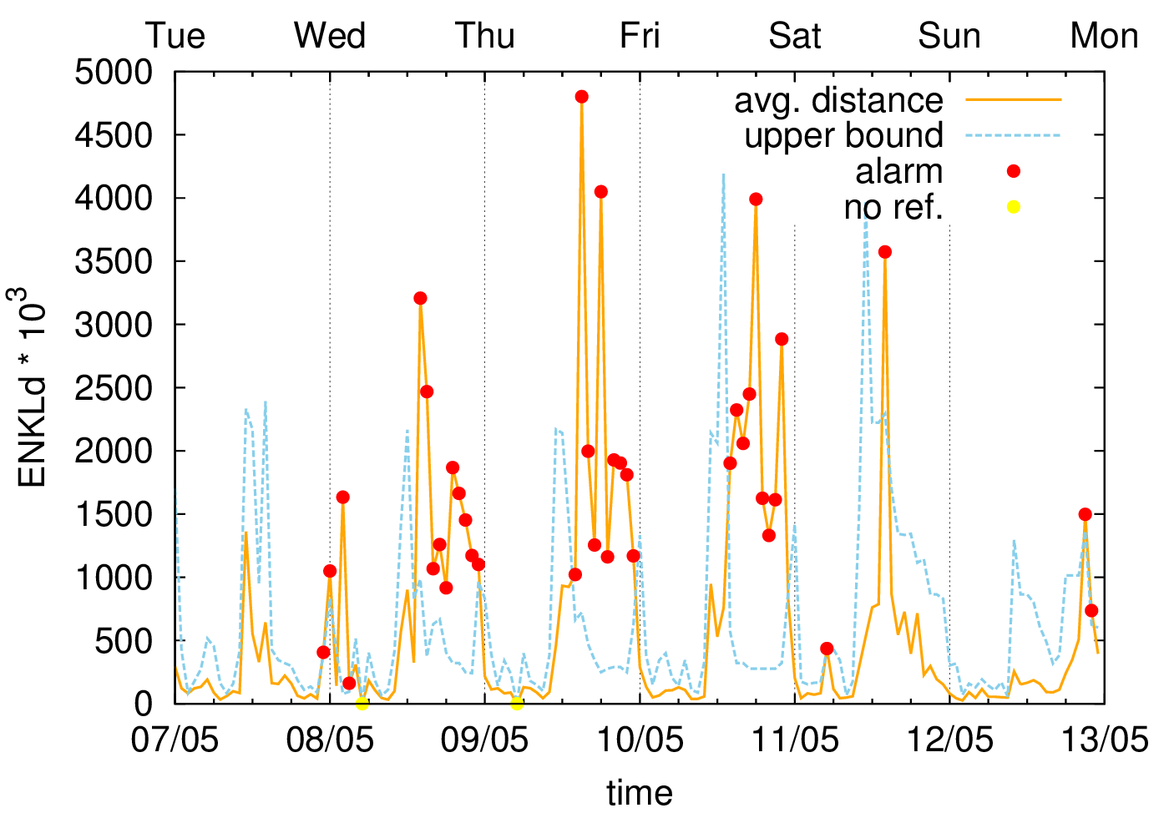
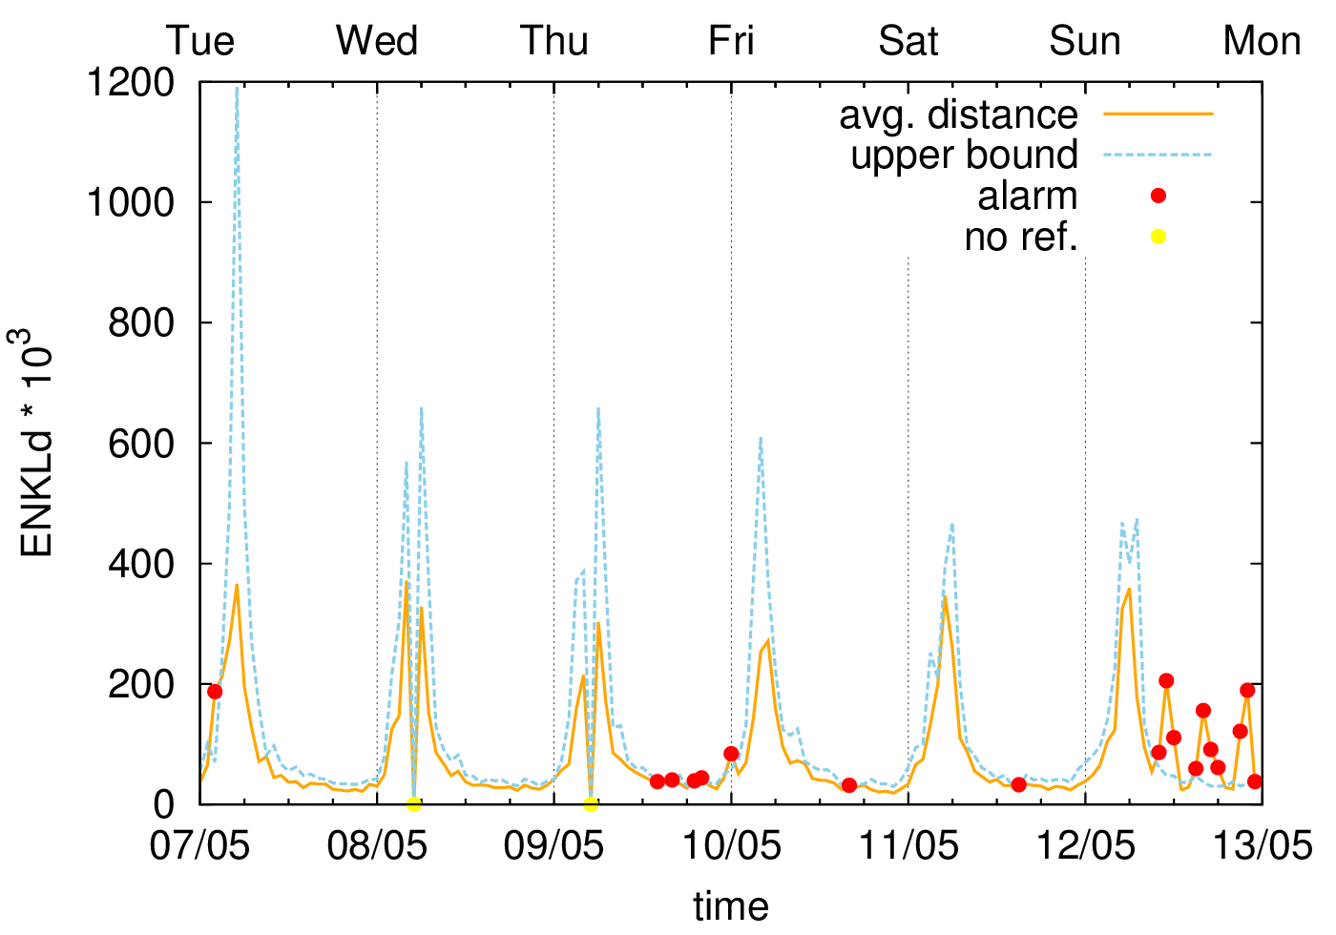
Youtube QoE anomaly: Diagnostic Signals
Distribution of flows across server IPs
Distribution of flows across remote elab. time
server IPs
change
elaboration time change
new servers are involved
new servers are under-dimensioned?
(also possible congestion)
Distribution of flows across external RTT bins
Distribution of flows across internal RTT bins
external RTT change
NO change internal RTT
possible congestion?
external cause
Pierdomenico Fiadino – Barcelona, Feb. 11th 2016...............
Slide #44

Slide 45
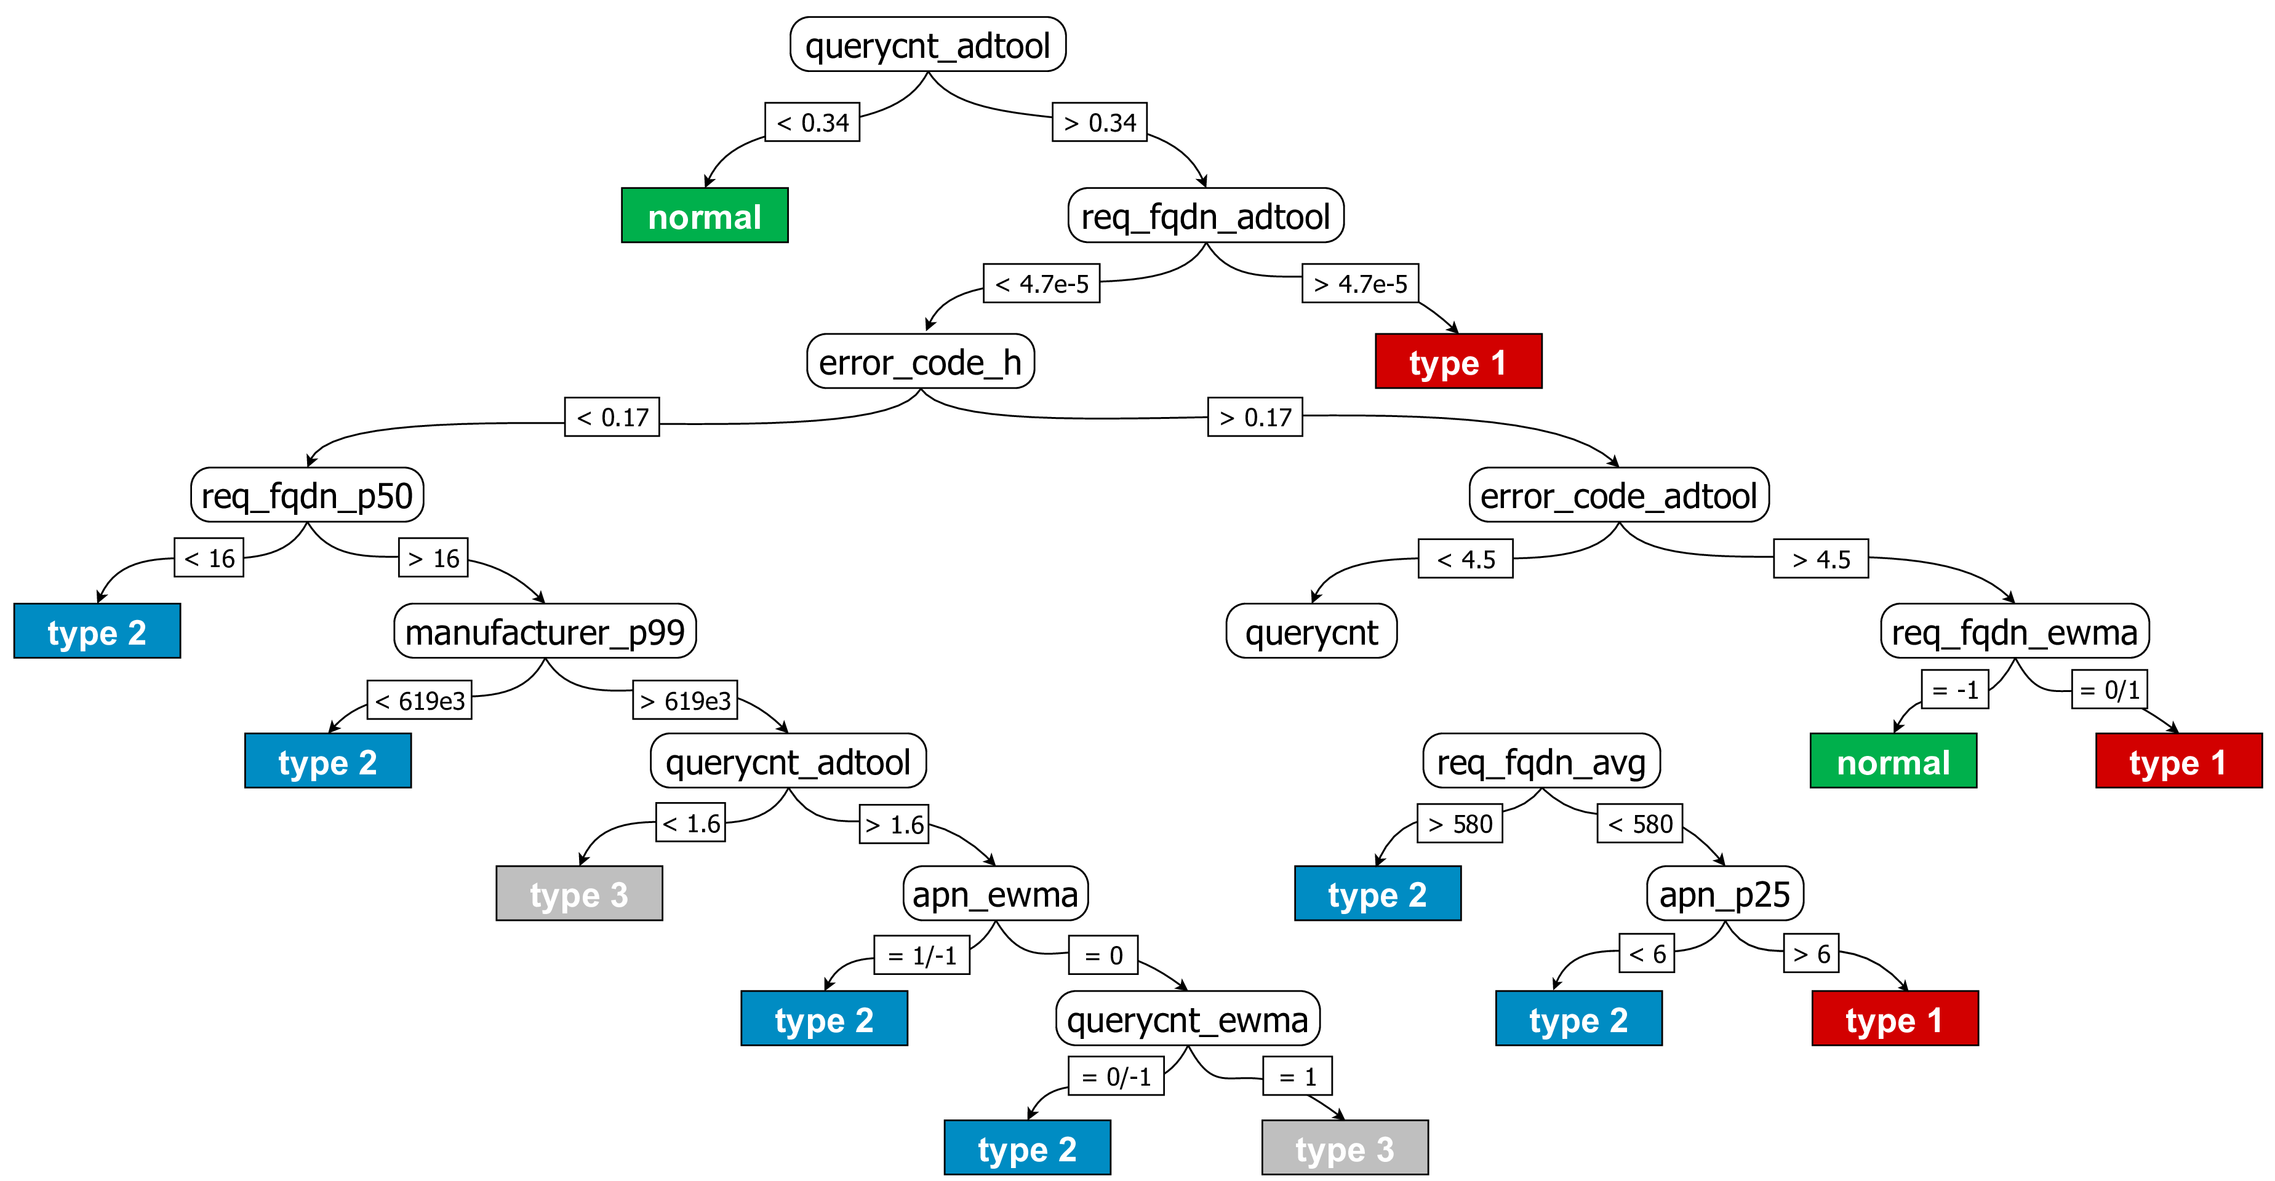
Stage #3: Diagnosis Module (anomaly classification)
111
Support Signal Correlation through ML
Classify detected anomalies (assign event lable)
Enrich final event reporting and support troubleshooting
Supervised classification techniques
Evaluation on synthetic dataset (from real DNS anomaly templates)
Datasets includes detector outputs as features
Several tested algorithms
(SVN, NB, DT, RF, MLP)
C4.5 (Decision Tree) best performing*
*Considering feature selection approaches
Pierdomenico Fiadino – Barcelona, Feb. 11th 2016...............
Slide #45

Slide 46
Stage #3: Diagnosis Module (state management)
111
State machine(s)
Add “inertia” to the system to track evolution of events
Keep states independently for each signal
Change Detection: from state-less to state-full
Normal
f_{r} = 0
Warning
0 < f_{r} < th
Anomaly
f_{r} ≥ th
More robust in presence of flipping detector output
Allows definition of
event-lifecycle
Supports better reporting
(especially long-term events)
Pierdomenico Fiadino – Barcelona, Feb. 11th 2016...............
Slide #46
Notes:
Dire meno dettagli su state machine che e‘ chiaro....

Slide 47
Diagnosis Module: event reporting
Event #123456 {Gran. 15 minutes}
Type 1
-----------------------------------
Symptoms:
* beta [0.75,+][1.25,-]
* throughput [4Mbps,+][8Mbps,-]
Correlated diagnostic signals:
* servers [AS2,+][AS1,-]
* external RTT [100ms,+][80ms,-]
* elaboration t. [50ms,+] [20ms,-]
Uncorrelated diagnostic signals:
* internal RTT […]
-----------------------------------
Timestamps:
Warning_start 2015-02-14 19:00
Alarm_start 2015-02-14 19:15
Alarm_end 2015-02-14 22:45
Warning_end 2015-02-14 23:00
event ID and type
(ML label)
decrease of throughput and beta
new servers
with higher RTT and elaboration time
internal RTT unchanged (external problem)
at peak time
(underdimensioned servers)
Pierdomenico Fiadino – Barcelona, Feb. 11th 2016...............
Slide #47

Slide 48
Anomaly Detection and Diagnosis -- Summary
my main
contributions
Study of many anomaly use cases (spanning different classes and network trace types)
Extension of a distribution-based detector system with a self-adapting reference identification mechanism
Design of a framework for parallel analysis of traffic features/signals
Machine Learning techniques for automatic classification of anomalies
Human-readable event reporting
my other contributions (not shown)
Study on entropy-based detectors and limitations
Distribution-based detectors applied on Facebook anomalies
Generation of synthetic traffic and anomaly injection
Comparison of entropy-based detectors against distribution-based
Novel Reference Identification Algorithm
Extended evaluation of distribution-based detectors on DNS anomalies (focusing on detection capabilities depending on anomaly-intensity)
IWCM 2014, ITC 201, CoNEXT 2014 Poster session
ACM SIGCOMM 2015 Poster ACM Student Research Competition - Runner Up
IWCMC 2015, ITC 2015, IEEE ComMag 2015 (to appear), JSAC 2015 (submitted)
publications
Pierdomenico Fiadino – Barcelona, Feb. 11th 2016...............
Slide #48

Slide 49
Conclusions (and open topics for future research)
111
1
Internet service differentiation
Rely on HTTP/DNS monitoring and manual definition of regular expression
contribution
Technique for classification of “big players” in a cyphered Internet
to-do
More scalable and less manual
2
Extensive characterization of Internet-scale services
Investigating hosting infrastructure, geo-topological diversity, flow characteristics and QoE
contribution
Structured methodology and
valuable results from real networks
to-do
Continue the characterization efforts, tackle new applications and patterns
3
Large-scale anomaly detection
Powerful distribution-based algorithm
contribution
Application on CDN-related issue and reference identification algo.
to-do
Concurrent anomalies
4
Towards Automatic Diagnosis of Anomalies
Supervised classification techniques, state management and automatic reporting
contribution
Human-readable anomaly description to support troubleshooting
to-do
Iterative/Distributed Diagnosis
(first, promising, results!)
Pierdomenico Fiadino – Barcelona, Feb. 11th 2016...............
Slide #49

Slide 50
Thank you for your attention!
publications
Q₁
HTTP(S) Classification
INFOCOM 2013 Poster Session (HTTP pattern-matching classification)
IWCMC 2013 (IP-based classifier)
ACM SIGCOMM 2014 Poster Session (DNS extension for encrypted protocols)
Q₂
Characterization of traffic from popular Internet-scale services
ITC 2013 (Internet’s big player, extended characterization) B.P.A.
PAM 2014 Poster session (Internet’s big players)
IWCM 2014 [1] (Facebook characterization)
IWCM 2014 [2] (YouTube anomaly, preliminary study)
EuCNC 2014 (YouTube characterization, cellular vs fixed line)
CNSM 2014 (YouTube characterization and QoE implications)
IEEE TNSM 2014 (YouTube anomaly study, extended)
ACM SIGCOMM 2014 Poster session (WhatsApp characterization)
WD 2014 (Youtube caching strategies) B.P.A. Runner Up
TMA 2015 (WhatsApp characterization, extended)
IFIP Networking 2015 (Characterization of traffic from online social networks)
EuCNC 2015 (QoE in online social networks)
IWCM 2015 (QoE in online social networks, extended)
Q₃
Anomaly Detection
And Diagnosis
IWCM 2014 [2] (Distribution-based techniques, exploratory study)
ITC 2014 (Distribution-based techniques applied on Facebook and YouTube anomalies)
CoNEXT 2014 Poster session (DNS anomalies and entropy-based detectors)
ACM SIGCOMM 2015 Poster (Limitations of entropy-based detectors) ACM Student Research Competition - Runner Up
IWCMC 2015 (Diagnosis framework, preliminary study applying entropy detectors)
ITC 2015 (Diagnosis framework applied on DNS anomalies)
IEEE ComMag 2015 (to appear, Diagnosis framework in mPlane)
JSAC 2015 (submitted, Diagnosis framework extended, YouTube experiments and ML)

Slide 51
backup slides

Slide 52
Passive Measurements
111
Access Network
internet
network operator
passive probe
devices
HTTP tickets
Characterization and Diagnosis
DNS tickets
network traces
Streaming data-warehouse (SQL)
TCP-level statistics
...
Pierdomenico Fiadino – Barcelona, Feb. 11th 2016...............
Slide #52

Slide 53
What to do next: Iterative Diagnosis
111
Capture
(passive)
Diagnosis
Capture
(active, passive, hybrid)
Import & Pre-process
(signal extraction)
Detect Changes
Iterative Diagnosis
Continuous Reporting
Set-up additional measurements (active/passive)
Sequential Diagnosis Scheme
Effective in most scenarios.
Mostly based on passive traces.
Tested in operational networks (e.g., DNS anomalies)
However, it might not be enough to diagnose probles outside operator‘s boundaries (sometimes)....
Iterative Diagnosis Scheme
Set-up existing measurements and/or access existing ones.
Distributed Vantage Points (federated measurement architecture)
More flexible time-granularity management

Slide 54



Distributed/Hybrid Measurement scheme
111
A
Active
probe
P
Passive
probe
reasoner
repository
data
control
A
A
Internet
eXchange
Point
IXP
client
access link
P
...
P
client
peering link

Slide 55
Iterative Diagnosis Graph
1
Youtube flow throughput distribution change
No
drop in QoE-related KPIs?
Yes
2
device/OS related issue?
Yes
No
extrat dominant
device/OS type
internal ISP diagnosis
Yes
ISP issue
3
No
device/soft issue
path congestion events?
Yes
inter-AS path issue
No
CDN load balancing?
4
No
Yes
path congestion events?
server problems?
server issues
5

Slide 56
Content Delivery Networks and load balancing
CDN Network
Local
DNS
upstream
AS path
Ingress
Router
?
Service
FEs
contents
(1) Client requests content to FE
(3) Client
resolves
content
server name
Front-end
(FE)
(2) FE replies with content server name
client
downstream
AS path
Egress
Router
Content
Servers
(4) Client requests content
client
Architecture
Workflow
Front-end servers handle user requests
Users are dinamically redirected
Located at multiple A.S.
Load-balancing through DNS differentiation
Many organizations, ASes and FQDNs are involved in providing the service

Slide 57
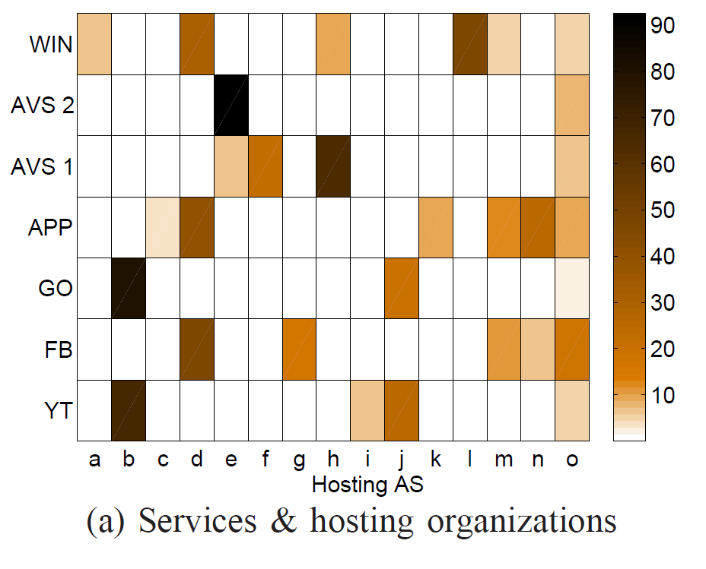
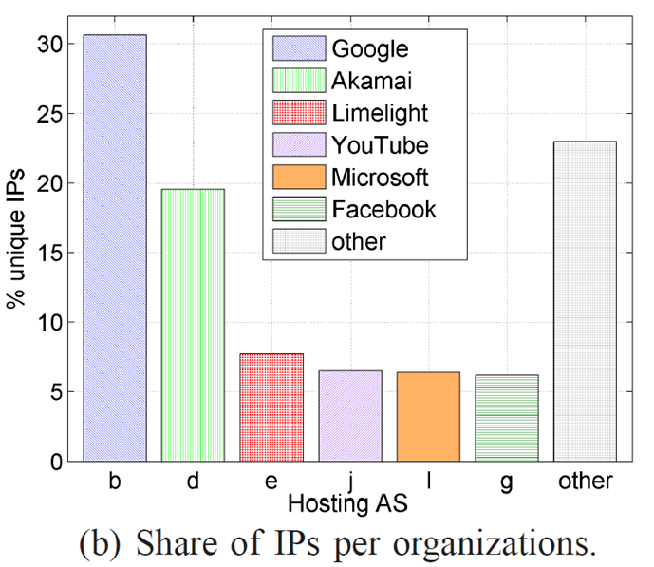

Internet Big Players (Hosting and Services)
a
h
Hotmail
Level 3
b
i
Google
Youtube AS1
d
j
Akamai EU
Youtube AS2
e
k
Limelight
Apple
f
l
Web Hoster
Microsoft
g
m,n,o
Facebook
ISPs
Services & hosting organizations
a
Different services hosted by multiple organizations
b
Akamai EU hosts a large share of Facebook, Apple, Windows
c
Non-cached Google/Youtube content exclusively hosted by Google.
d
Most IP of top services hosted by Google and Akamai

Slide 58
Internet Big Players (Hosting Companies)
Where the traffic is flowing from: an ISP perspective
CDN
#IPv4
#AS
#/24
Google
~660k
8
~2.5K
Cellular network, 1Ms users, 2014
Akamai
~3.5M
22
~14K
Limelight
~110K
8
~400
LeaseWeb
~480K
3
~1.8K
a
Association IP-AS
b
Few CDNs dominate Internet landscape
c
Top 4 host 40% of contents
Google CDN, Akamai, Limelight, LeaseWeb
d
Content caching at ISP
depending on vantage point

Slide 59
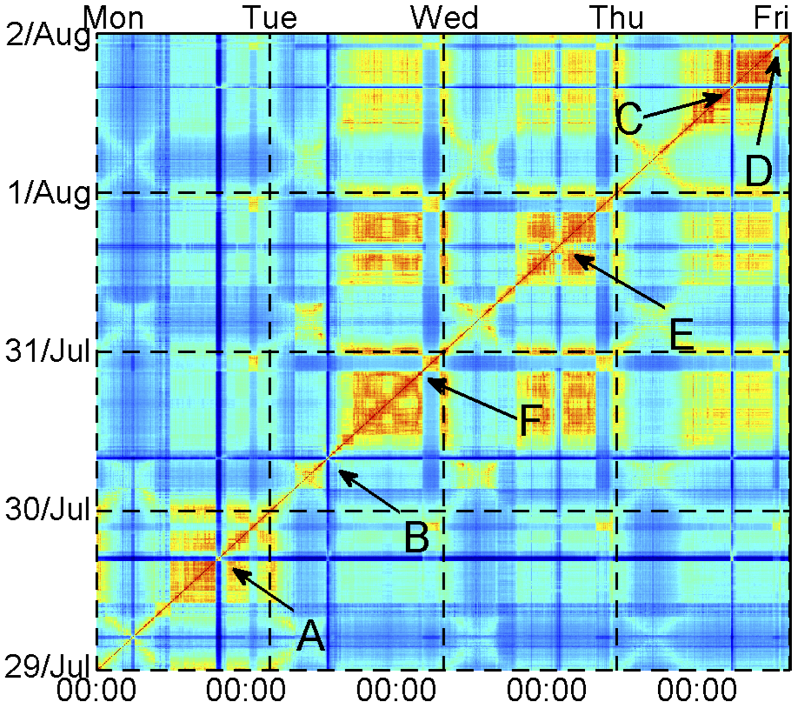
Visualization of temporal patterns
111
Temporal Similarity Plot (TSP)
A powerful heatmap-like tool for visualizing temporal patterns
Discover temporal patterns and (ir)regularities in distribution timeseries

Slide 60
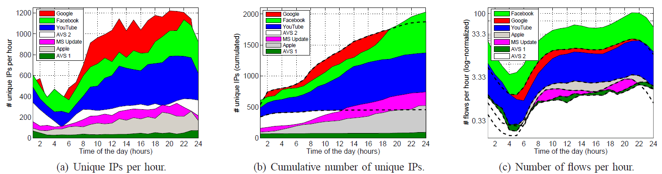
Temporal Dynamics: IP utilization per hour
Unique IPs per hour
Cumulative number of IPs
Number of flows per hour
a
Number of single IPs/hour providing HTTP services vary during day
From few 10s to 1000s different IP addresses per day
b
Google Search, YouTube and Facebook domanite the IP space
Because of their largerger volume and user base
c
Facebook is the most IP-distributed service (thanks to Akamai)
More than 2000 different IPs/day
d
Some services (e.g., AVS1) provisioned by very stable delivery infrastructure
Negligible changes in IP addresses active over the day

Slide 61
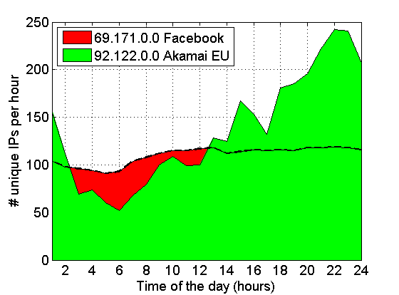
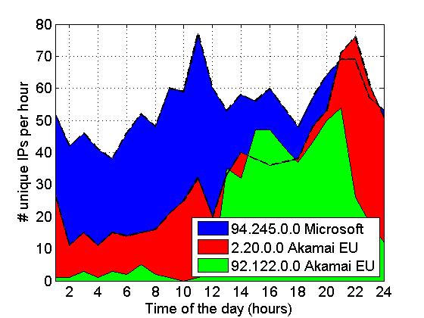
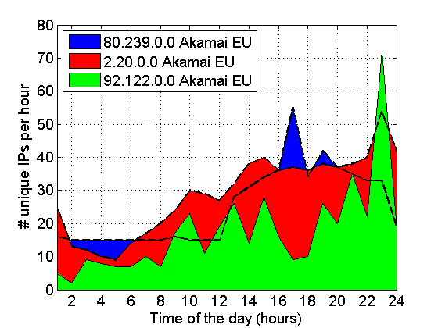
Temporal Dynamics: IP utilization per hour
Facebook IPs
Windows Update IPs
Facebook
MS Windows Updates
Apple‘s iTunes and App Store
a
Different subnets of the CDNs are more dynamic than others
b
Akamai flows are serverd from very dynamically changing locations
Akamai places machines in operators‘ networks
c
``on demand´´ provisioning servers: Akmai‘s CDN philosophy
Akamai is among the most distributed and dynamic CDNs
d
Akamai flows are, a-priori, more difficult to track using servers Ips
It‘s extremely hard to track Akamai-based services by operators

Slide 62
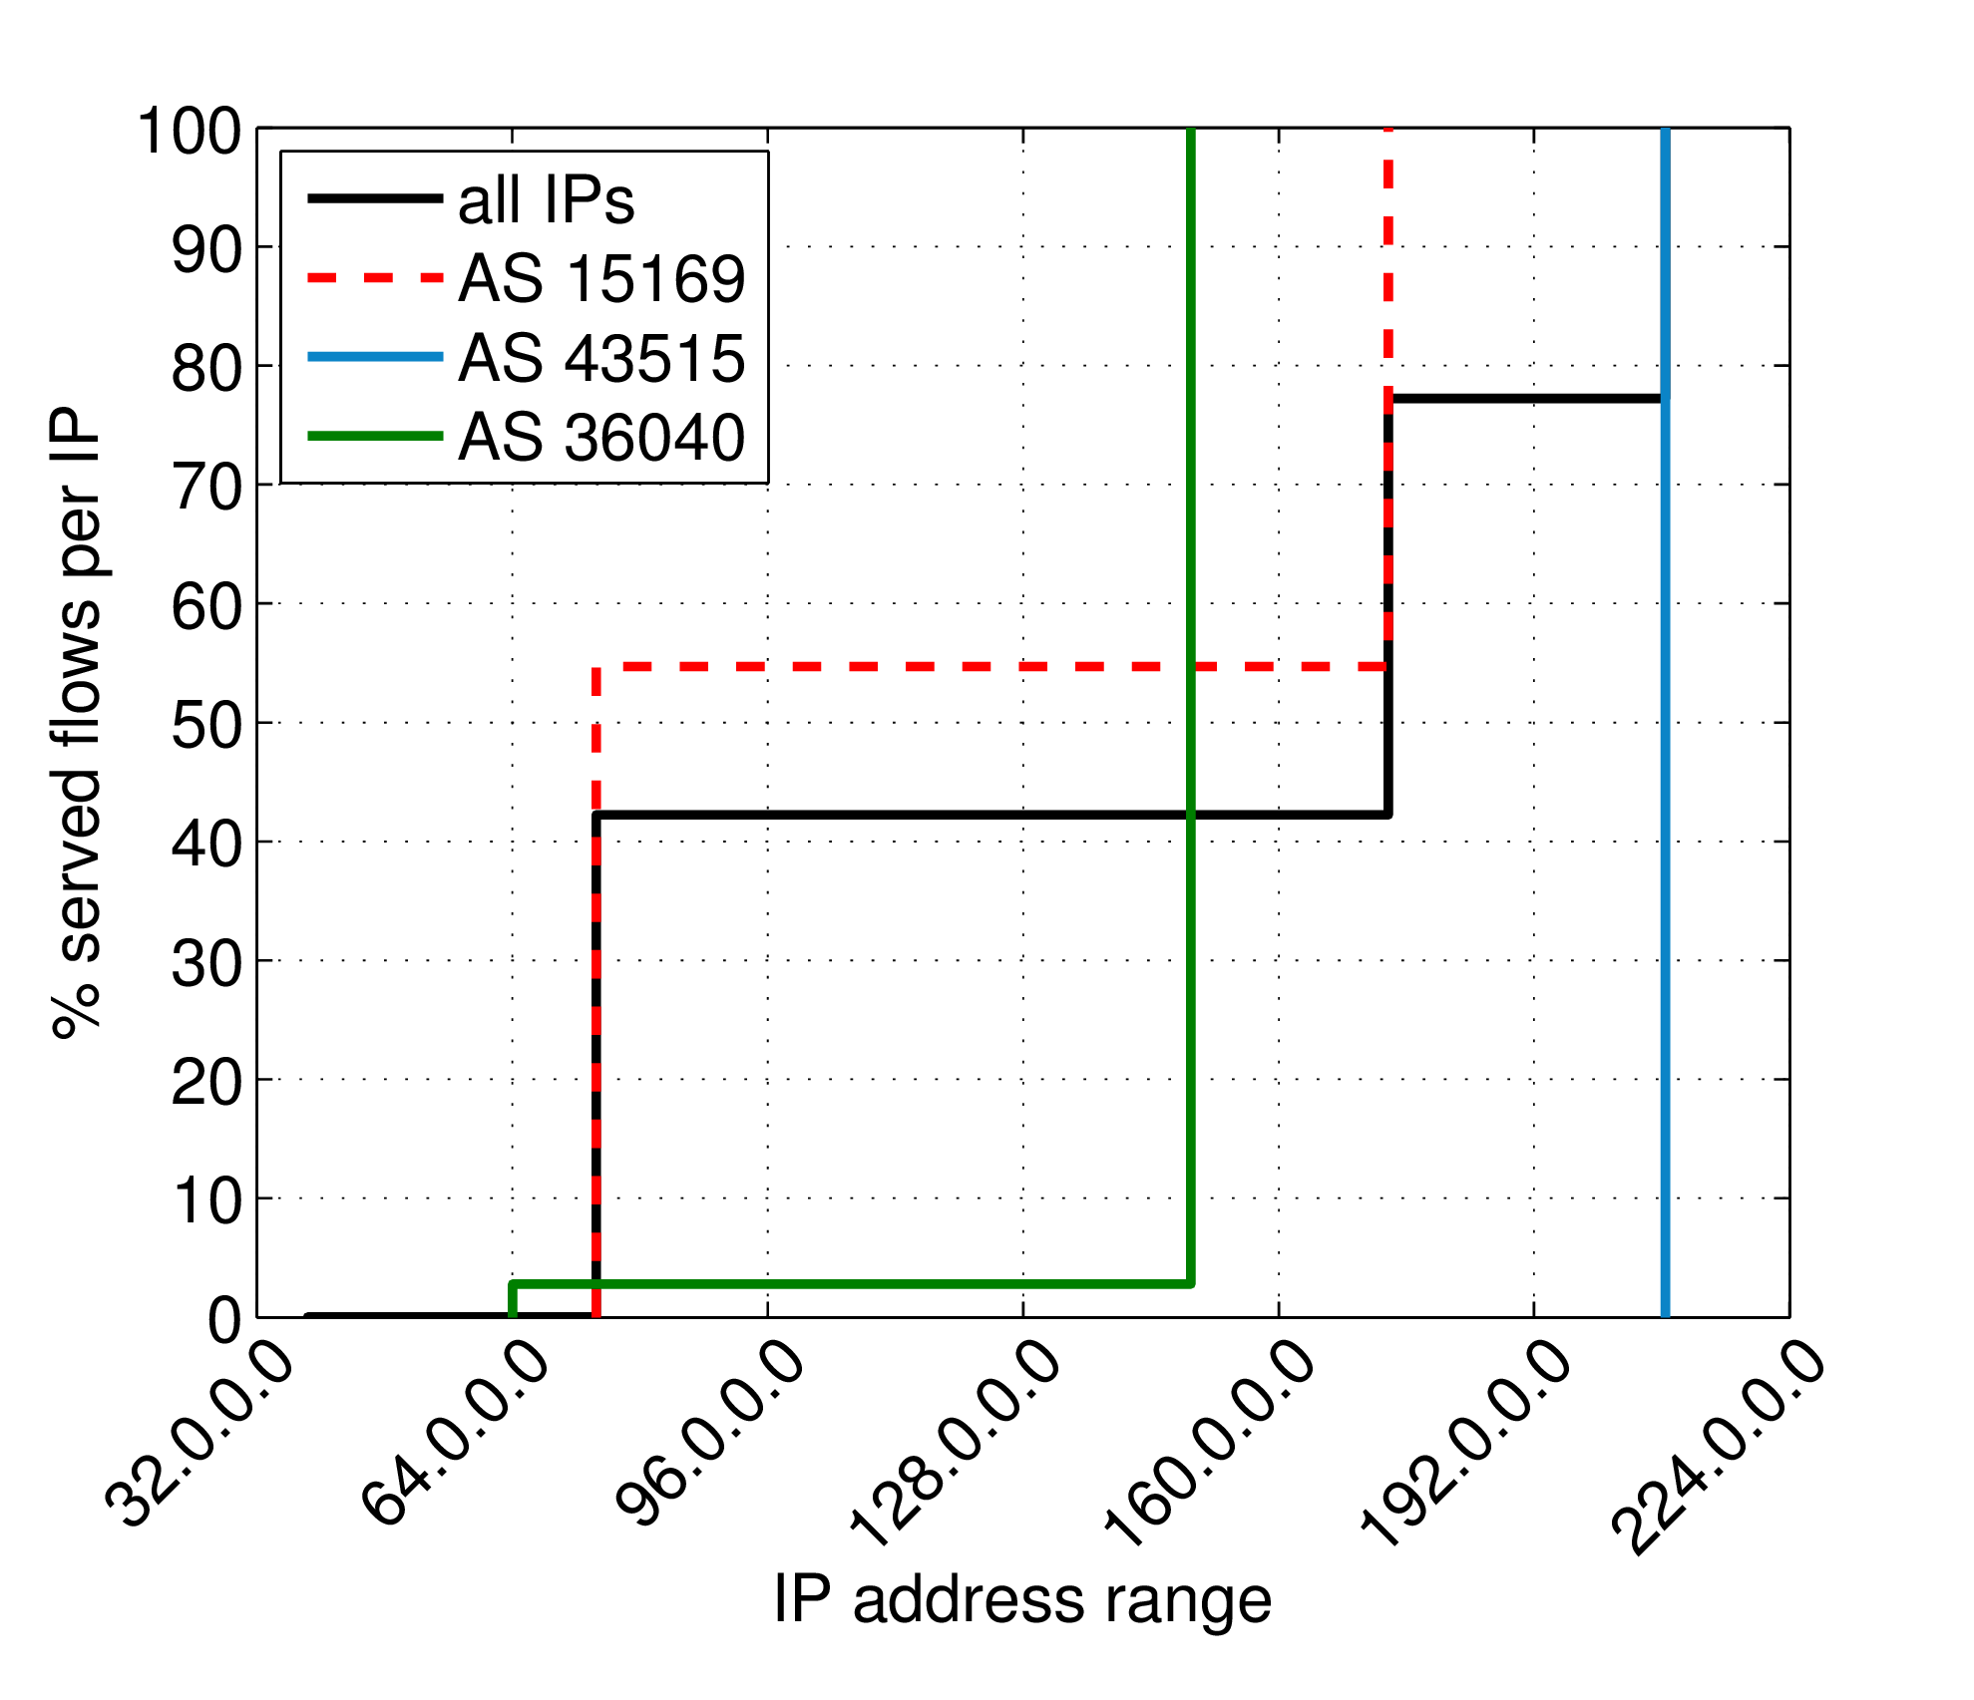
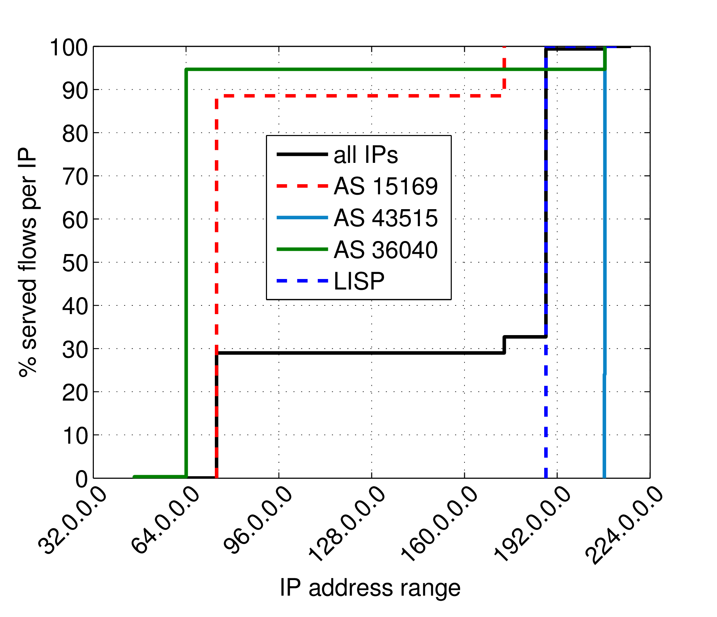
YouTube: cellular vs fixed-line (addressing space)
Comparing YouTube characteristics from two different perspectives
Fixed-line dataset (1000s customers)
Cellular dataset (1Ms customers)
1
2
3 Google Autonomous Systems
3600 IP addresses
100 networks/24
One of the two Google AS (spanning two /16) plays major role
3 Google Autonomous Systems
2000 IP addresses
63 networks/24
Local ISP AS (spanning one /16) plays an important role, serving 70% of flows!
Distribution of Youtube flows in the IPv4 addressing space (fixed-line vs cellular)

Slide 63
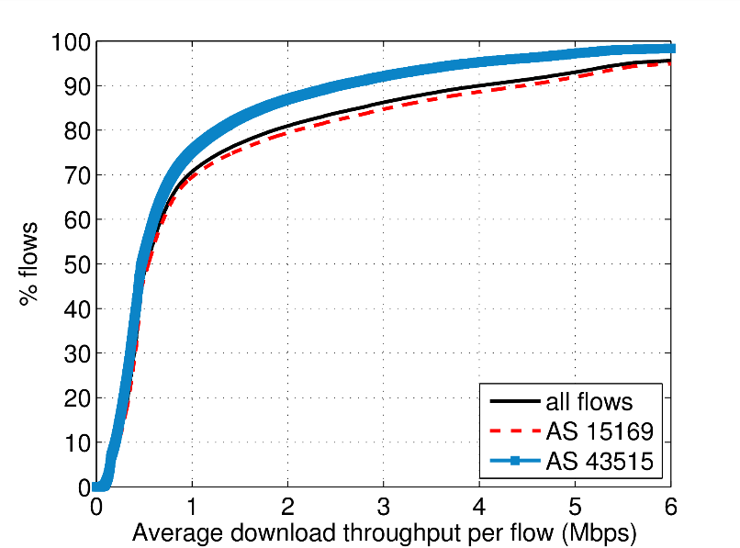
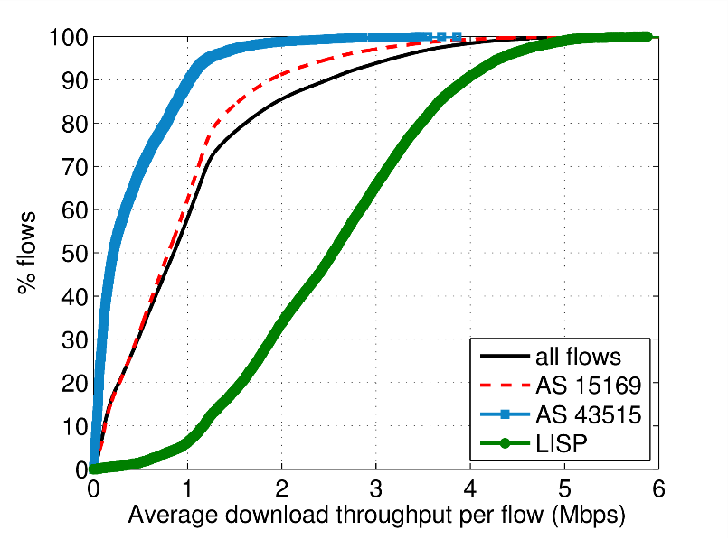
YouTube: cellular vs fixed-line (flow characteristics)
Comparing YouTube characteristics from two different perspectives
Fixed-line dataset (1000s customers)
Cellular dataset (1Ms customers)
1
2
More than 15% flows achieve >2Mbps
Throughput governed by video bit-rate (not access technology!)
More than 15% flows achieve >2Mbps
Throughput governed by video bit-rate (not access technology!)
Highest througput from local ISP
Advantage of caching

Slide 64
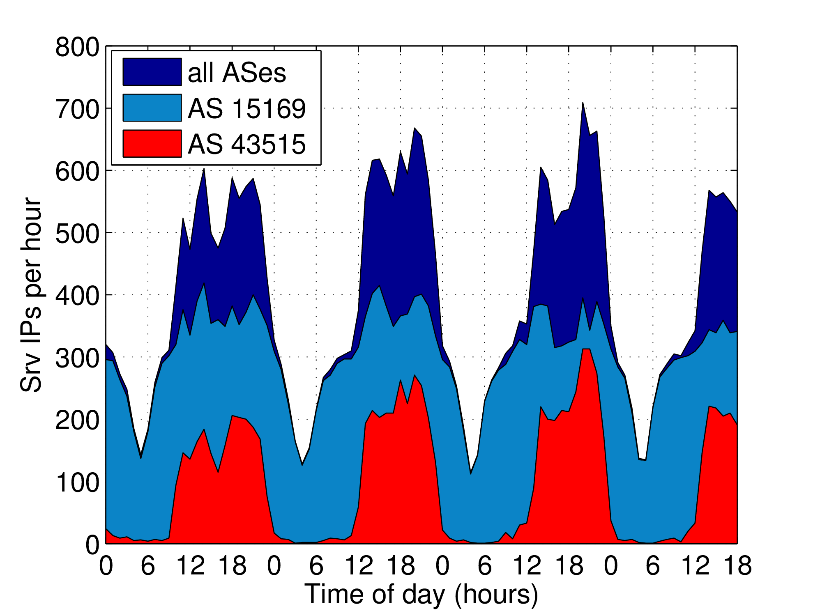
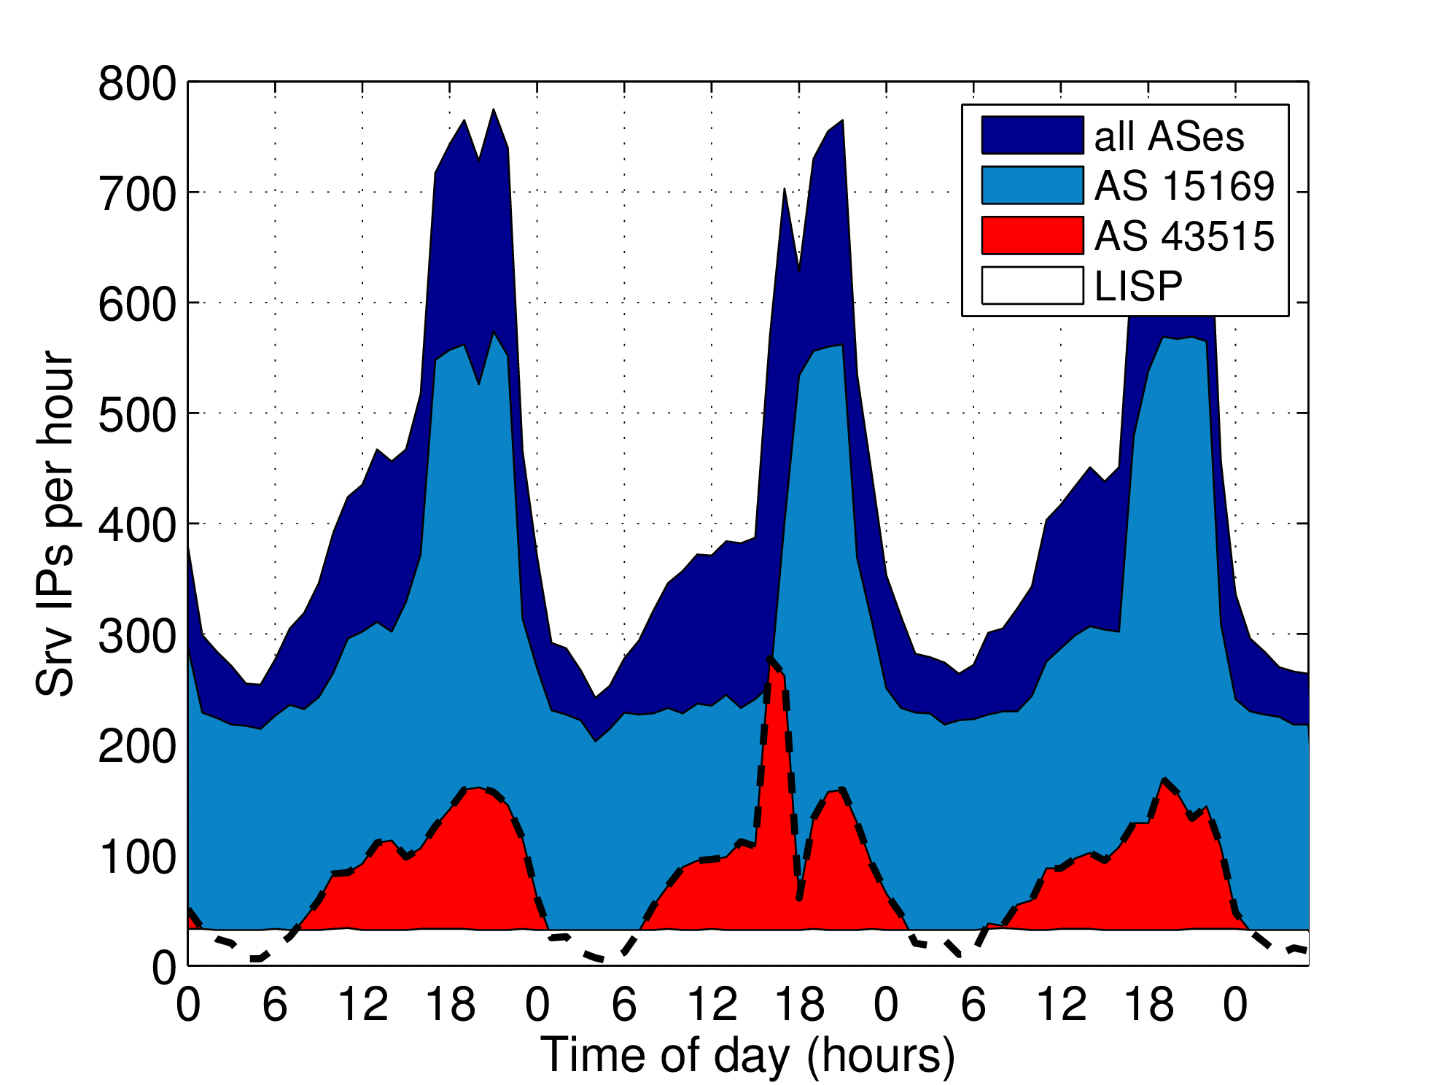
YouTube: cellular vs fixed-line (IP activity)
111
Comparing YouTube characteristics from two different perspectives
Fixed-line dataset (1000s customers)
Cellular dataset (1Ms customers)
1
2
Up to 700 IPs active at peak times
Load balancing depending on time of the day (very evident)
Up to 700 IPs active at peak times
Load balancing depending on time of the day (slightly less evident)
Local IPs are always on
More predictable dynamics (long-run)

Slide 65
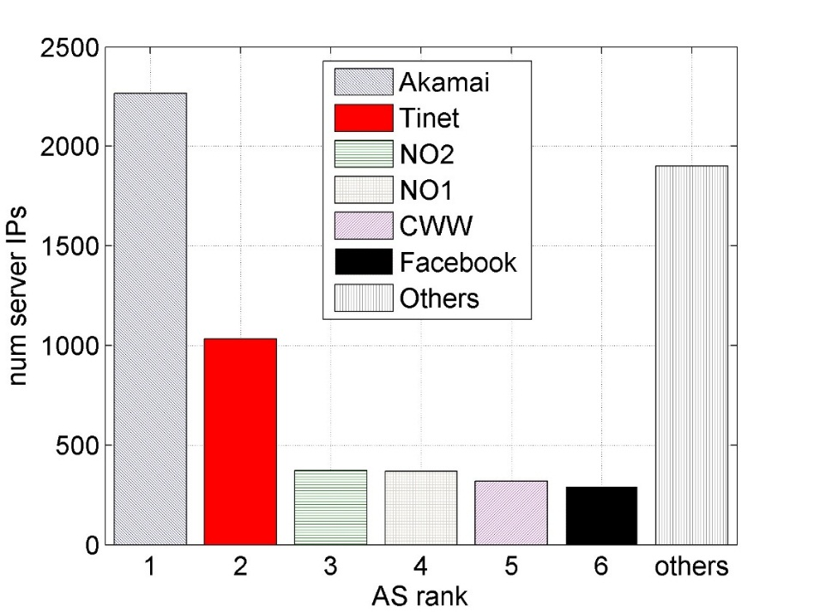
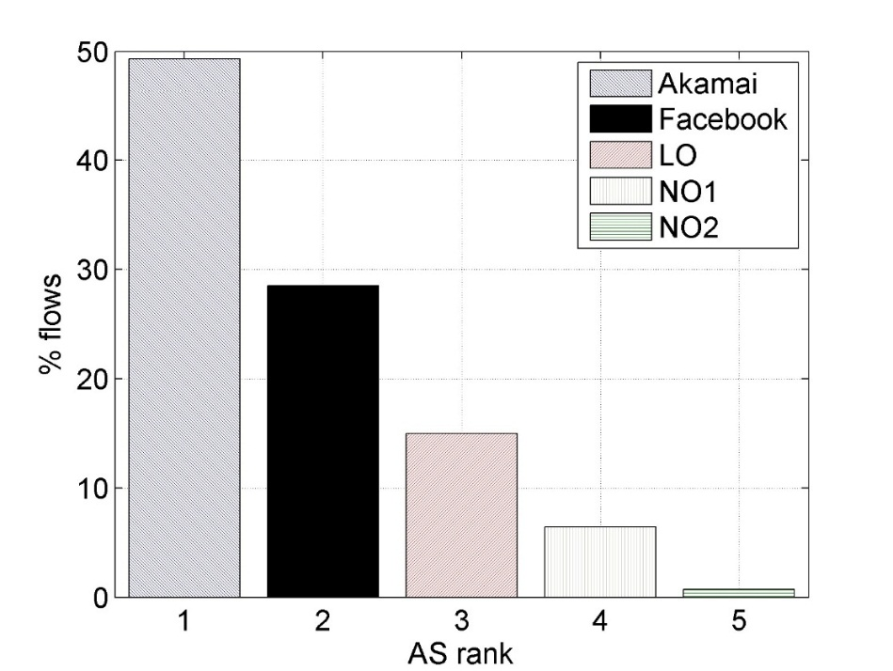
A. Hosting Infrastructure (Facebook case)
Topological diversity
Number of IP addresses per A.S.
Share of flows per A.S.
a
Akamai, Facebook AS, Tinet, CWW and neighbor operators
main involved ASses
b
Akamai plays a key role
50% of flowss and 2600 IP addresses
c
Local and neighbor operators
caches

Slide 66
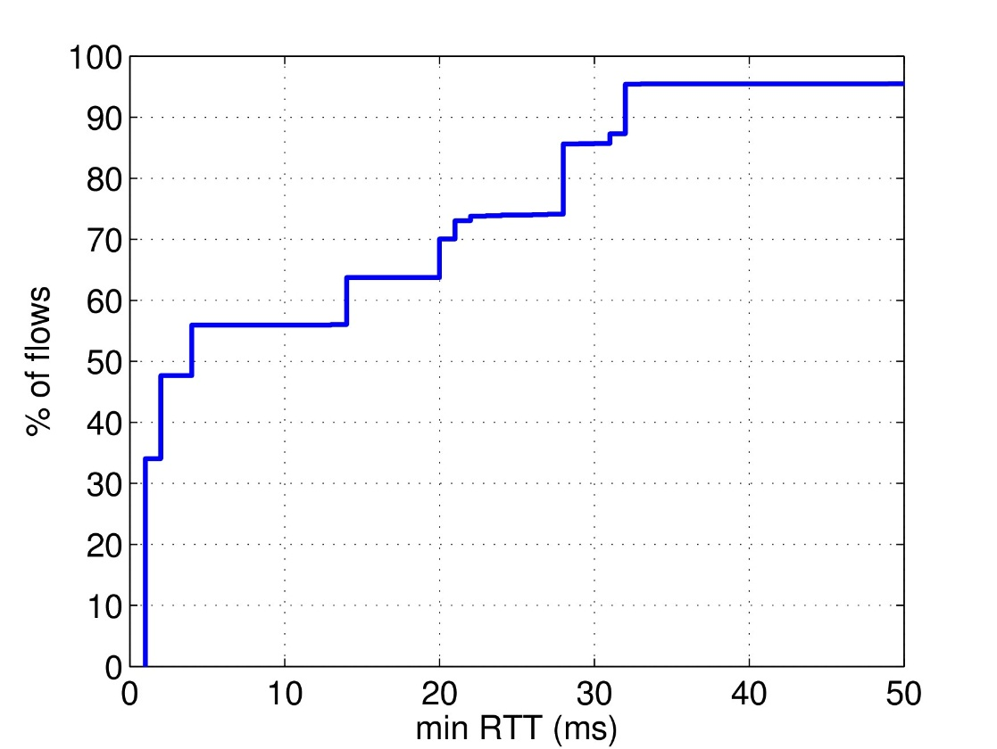

A. Hosting Infrastructure (Facebook case)
111
minumum RTT for all server IPs
minimum RTT for top hosting A.S.
a
minnRTT approximate delay
Knees in the distributions correspond to hosting locations
b
Akamai AS: very short RTT (highly distributed and close to final users)
c
Facebook AS: three knees (Ireland
+ locations in USA through local IXP)
d
Intuitively network operators have small geographical diversity

Slide 67
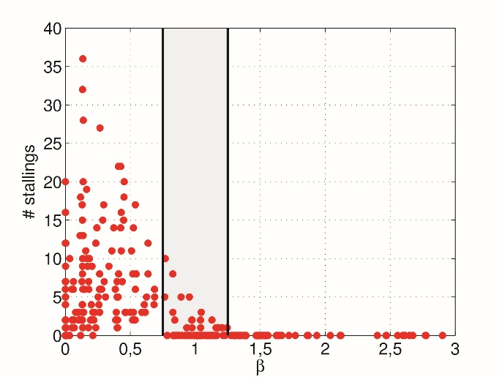
A better QoE Key Performance Indicator (KPI)
111
Idea
Throughput alone does not give information of user‘s perceived experience
Correlate it with Video Bit Rate
ADT
Average Download Throughput
β = ADT/VBR
metric reflecting user experience
VBR
Video Bit Rate
if (ADT<VBR) then low β and video stallings
hence bad QoE
from LAB tests
No stallings
with β>1.25
High QoE (MOS>4) with β>1.25
β-parameter vs. video stallings

Slide 68
DNS anomalies: the mobile operators´ plague
111
Device-specific anomalies affecting sub-populations
Observed multiple instances in few months
Impacting operator-managed DNS servers and signaling plane
?
DNS
server
?
device-specific push/cloud services
?
?
?
#DNS queries
#DNS queries
#DNS queries
requested hostnames (FQDN)
manufacturers
Operating systems

Slide 69
Traffic Feature Distributions
111
Distribution of DNS queries across device manufacturer
Devices affected by an anomaly induce a change in traffic feature distributions
Apple
Samsung
number of DNS queries
Huawei
HTC
LG
manufacturers
Pierdomenico Fiadino – Barcelona, Feb. 11th 2016...............
Slide #69

Slide 70
Detection Module
111
traces
signal extr.
change
detection
diagnosis
signal extr.
change
detection
Tested two alternative detection strategies
Entropy-based and distribution-based
Based on anomaly detection tool(s) from previous works, improved
Improved distribution-based with new reference identification algorithm
Key module for the whole framework

Slide 71
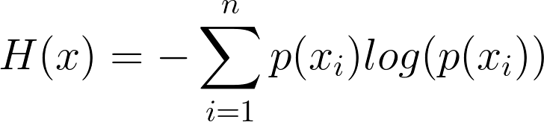
Two Alternative Detectors
111
First tested detector: Entropy-based
Represent entiro distribution as Entropy
111
H_{f}(t₀) = 0.42
feature f distribution at t₀
2015-08-18 08:00
Entropy
Entropy captures the dispersion of the corresponding distribution
A change in traffic patterns induces a change (spike/notch) in the entropy of the relevant traffic feature

Slide 72
Two examples of DNS events
111
 | Event #1 | Event #2
Start time | 9:00 | 12:00
Duration | 1 hour | 2 days
Devices | 10% | 5%
Back-off time | 5 seconds | 180 seconds
Manufacturer | Apple Inc. | Multiple (Samsung, HTC, ...)
O.S. | iOS 8.* | Android 4.*
Error flag | +5% time-outs | --
FQDN | OS-specific Top 3LD (push.apple.com) | OS-specific Top 3LD (mtalk.google.com)
P. Fiadino – PhD Defense – Deceber 10th, 2015...............
Slide #72

Slide 73
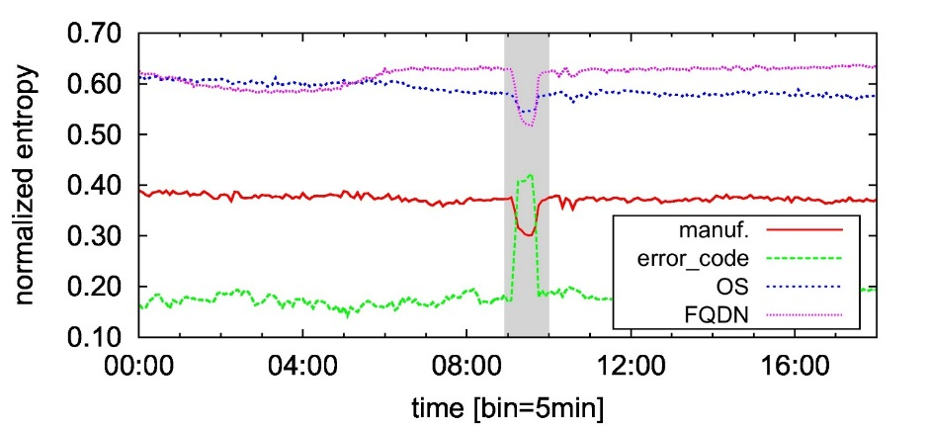
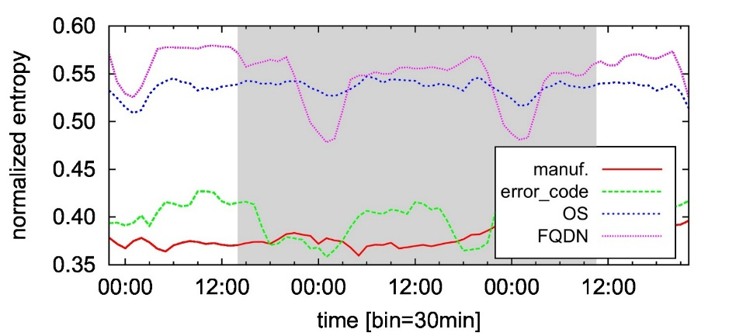
Detectors Output
111
Detector #1: Entropy-based
DNS event #1 (Apple)
DNS event #2 (Android)
Entropy of relevant features is clearly altered
Entropies are not clearly altered
Easily detectable by change-point-detection algorithms (e.g., EWMA)
EWMA fails in detecting the whole duration of the anomaly

Slide 74


Detectors Output
111
Detector #2: Distribution-based
DNS event #1 (Apple)
DNS event #2 (Android)
Both events exhibit a clear divergence from normality reference
The whole duration of the anomaly is detected

Slide 75




Comparing other detection solutions
111
ROC Curves
Event Type #1
Event Type #2
(legacy)
Entropy-based
detector
(endorsed)
Distribution-based
detector

Slide 76
Diagnosis Module (DNS anomaly reporting)
Event #123456 {Gran. 30 minutes}
Type 1
-----------------------------------
Symptoms:
* query_cnt [10,+][1,-]
Correlated diagnostic signals:
* manufacturer [Samsung,+]
* operative_sys [Android 4.1.2,+]
* FQDN [youcloud.com,+]
Uncorrelated diagnostic signals:
* error code […]
* APN […]
-----------------------------------
Timestamps:
Warning_start 2015-02-14 13:00
Alarm_start 2015-02-14 13:30
Alarm_end 2015-02-16 11:00
Warning_end 2015-02-16 12:00
event ID and type
(ML label)
increase of users executing
1 query / 3 minuties
Samsung users running Android 4.1.2, resolving youcloud.com
APN independent, error code distribution is not impacted
for almost 2 days

Slide 77


Revealing WhatsApp´s Hosting Infrastructure
111
386 IP adresses used by Whatsapp (chat and media)
All in AS36351 (Softlayer)
Service/AS | #IPs | # /24 | # /16 | # /8
WhatsApp | 386 | 51 | 30 | 24
SoftLayer (AS36351) | 1364480 | 5330 | 106 | 42

Slide 78


Revealing WhatsApp Hosting Infrastructure
111
Localization of servers through MaxMind and minimum RTT
400 IP addresses observed
all in Softlayer AS
1
MaxMind-located in:
Houston
Dallas
2
geographical localization
2 seps in RTT distribution
106 ms
114 ms
3
topological localization

Slide 79

Revealing Whatsapp Hosting Infrastructure
111
IP addresses activity
150 IPs ``always on´´
Chat servers (XMPP)
25 IPs ``always on´´
Image transfer servers (HTTPS)
Up to 100 IPs at peak times
Video exchange servers (HTTPS)
Up to 75 IPs at peak times
Audio exchange servers (HTTPS)
at least 200 IPs are active at any time of the day

Slide 80

WhatsApp flow characteristics
111
flow size
flow throughput
Smaller chat/control flows and heavier media flows
Only bigger flows considered (>1MB)
90% chat flows < 10KB
Up to 1.5Mbps in downlink
50% media flows > 70KB
Up to 800Kbps in downlink

Slide 81


WhatsApp flow characteristics and terminal O.S.
111
flow duration (chat flows) [m]
flow duration (mm flows) [m]
Blackberry
Android
15 min
10/15/25 min
iOS
timeouts
3 min
15 min
Blackberry
Windows Phone
10 min
WhatsApp flow characteristics depend on terminal operating system

Slide 82

C. Flow Characteristics and QoE (WhatsApp)
111
Distribution of download time (as seen in large-scalepassive traces)
[video exchange in chat application]
40% flows last less than 20s (good)
60% flows last less than 40s (acceptable)
35% flows are badly/very badly perceived
From laboratory experiment to operational networks
Mean Opinion Score (MOS)
from 1 (very bad)
to 5 (excellent)
QoE model (download time/MOS)
Laboratory, 50 (27 f, 25m)
23 average age
Experiment
Controlled media file transfer (5MB)
Emulation of different network conditions
(change transfer time)
Users tolerate transfers (in chat apps) of up to 20 seconds with good experience
Threshold of 40 seconds discriminates good and bad experience
The score is independent of the flow size (e.g., independent of video quality)
Laboratory Experiments
Results
Notes:
Remove details on model and just put the conclusions and of the model and how they apply

Slide 83

Measuring QoE through lab experiments
111
Measurements campaign
50 participants (27 f, 25m)
45/55 male/female
60/40 students/employees
23 average age
Experiment
Media file transfer (5MB)
Emulation of different network conditions
(change transfer time)
Mean Opinion Score (MOS):
From 1 (very bad) to 5 excellent
Users tolerate transfers of up to 20 seconds with good experience
Threshold of 40 seconds discriminates good and bad experience
The score is undependent of the flow size
QoE model
transfer time / user score

Slide 84


From network measurements to QoE estimation
111
User tests: 5MB transfers, <20s good, >40s bad (previous slide
Assumption: flow size is not taken into account
Apply same model on large scale network traces
40% flows last less than 20s (good)
60% flows last less than 40s (acceptable)
35% flows are badly/very badly perceived

Slide 85



The big WhatsApp outage: Feb. 22nd 2014
111

Slide 86


The big WhatsApp outage: Feb. 22nd 2014
111
Drop in volume down
(with small residual traffic)
Drop in volume up
(with small residual traffic)
Ramp-up on flow counts
(SYN/RST exchange)
#whatsappdown
During outage: residual traffic with flow count increase (servers still reachable, failure at application layer)
Clear social media reactions

Slide 87

Facebook world-wide outage: Sept. 2014
Outages are typically not linked to CDN load-balancing policies
nevertheless, they can still involve the source ASes in different ways
Drop in Akamai´s volume
1
Other ASes do not take over
2
Increase of HTTP 5XX errors
3
User perceived impairment
4

Slide 88
Reference Identification Algorithm
111
L₀ = initial window length
L(t_{i}) = window length at t_{i}
t₀ = first time-bin
= normal time-bin
t₀ = anomalous time-bin
t_{i}
t_{j}
sliding window
t₀
time
L(t₀) = L₀
During normal behavior

Slide 89
Reference Identification Algorithm
111
L₀ = initial window length
L(t_{i}) = window length at t_{i}
t₀ = first time-bin
= normal time-bin
t₀ = anomalous time-bin
t_{i}
t_{j}
sliding window
t₁
time
L(t₁) = L₀
During normal behavior

Slide 90
Reference Identification Algorithm
111
L₀ = initial window length
L(t_{i}) = window length at t_{i}
t₀ = first time-bin
= normal time-bin
t₀ = anomalous time-bin
t_{i}
t_{j}
sliding window
t₂
time
L(t₂) = L₀
During normal behavior

Slide 91
Reference Identification Algorithm
111
L₀ = initial window length
L(t_{i}) = window length at t_{i}
t₀ = first time-bin
= normal time-bin
t₀ = anomalous time-bin
t_{i}
t_{j}
freeze window
t_{m}
time
L(t_{m}) = L₀
anomaly start
option
#1
Freeze window (avoind including anomaly in the reference

Slide 92
Reference Identification Algorithm
111
L₀ = initial window length
L(t_{i}) = window length at t_{i}
t₀ = first time-bin
= normal time-bin
t₀ = anomalous time-bin
t_{i}
t_{j}
freeze window
t_{m+1}
time
L(t_{m+1}) = L₀
anomaly continues...
option
#1
Freeze window (avoind including anomaly in the reference

Slide 93
Reference Identification Algorithm
111
L₀ = initial window length
L(t_{i}) = window length at t_{i}
t₀ = first time-bin
= normal time-bin
t₀ = anomalous time-bin
t_{i}
t_{j}
freeze window
t_{m+2}
time
L(t_{m+2}) = L₀
anomaly continues...
option
#1
Freeze window (avoind including anomaly in the reference

Slide 94
Reference Identification Algorithm
111
L₀ = initial window length
L(t_{i}) = window length at t_{i}
t₀ = first time-bin
= normal time-bin
t₀ = anomalous time-bin
t_{i}
t_{j}
freeze window
t?
time
L(t_{m+1}) = L₀
old reference!
potentially forever
option
#1
Freeze window (avoind including anomaly in the reference

Slide 95
Reference Identification Algorithm
111
L₀ = initial window length
L(t_{i}) = window length at t_{i}
t₀ = first time-bin
= normal time-bin
t₀ = anomalous time-bin
t_{i}
t_{j}
rewind...
inflate window (right)
t_{m}
time
L(t_{m}) = L₀
anomaly start
option
#2
Self-adapting window
(inflating phase)

Slide 96
Reference Identification Algorithm
111
L₀ = initial window length
L(t_{i}) = window length at t_{i}
t₀ = first time-bin
= normal time-bin
t₀ = anomalous time-bin
t_{i}
t_{j}
inflate window (right)
t_{m+1}
time
L(t_{m+1}) = L₀+1
option
#2
Self-adapting window
(inflating phase)

Slide 97
Reference Identification Algorithm
111
L₀ = initial window length
L(t_{i}) = window length at t_{i}
t₀ = first time-bin
= normal time-bin
t₀ = anomalous time-bin
t_{i}
t_{j}
inflate window (right)
t_{m+2}
time
L(t_{m+2}) = L₀+2
option
#2
Self-adapting window
(inflating phase)

Slide 98
Reference Identification Algorithm
111
L₀ = initial window length
L(t_{i}) = window length at t_{i}
t₀ = first time-bin
= normal time-bin
t₀ = anomalous time-bin
t_{i}
t_{j}
Hard test
do not include anomalous time-bin in the test
inflate window (right)
t_{m+3}
time
L(t_{m+3}) = L₀+3
option
#2
Self-adapting window
(inflating phase)

Slide 99
Reference Identification Algorithm
111
L₀ = initial window length
L(t_{i}) = window length at t_{i}
t₀ = first time-bin
= normal time-bin
t₀ = anomalous time-bin
t_{i}
t_{j}
Soft test
include all time-bins in the test
inflate window (right)
t_{m+n}
time
L(t_{m+n}) = 2 x L₀
option
#2
Self-adapting window
(freeze phase)

Slide 100
Reference Identification Algorithm
111
L₀ = initial window length
L(t_{i}) = window length at t_{i}
t₀ = first time-bin
= normal time-bin
t₀ = anomalous time-bin
t_{i}
t_{j}
freeze window and shift
t_{k}
time
L(t_{k}) = 2 x L₀
option
#2
Self-adapting window
(freeze phase)

Slide 101
Reference Identification Algorithm
111
L₀ = initial window length
L(t_{i}) = window length at t_{i}
t₀ = first time-bin
= normal time-bin
t₀ = anomalous time-bin
t_{i}
t_{j}
deflate (left) and shift
t_{k+1}
time
L(t_{k+1}) = 2 x L₀ - 1
option
#2
Self-adapting window
(deflate phase)

Slide 102
Reference Identification Algorithm
111
L₀ = initial window length
L(t_{i}) = window length at t_{i}
t₀ = first time-bin
= normal time-bin
t₀ = anomalous time-bin
t_{i}
t_{j}
deflate (left) and shift
t_{k+2}
time
L(t_{k+2}) = 2 x L₀ - 2
option
#2
Self-adapting window
(deflate phase)

Slide 103
Reference Identification Algorithm
111
L₀ = initial window length
L(t_{i}) = window length at t_{i}
t₀ = first time-bin
= normal time-bin
t₀ = anomalous time-bin
t_{i}
t_{j}
t_{n}
time
L(t_{n}) = L₀
option
#2
Self-adapting window
(back to normal)

